Slide 1
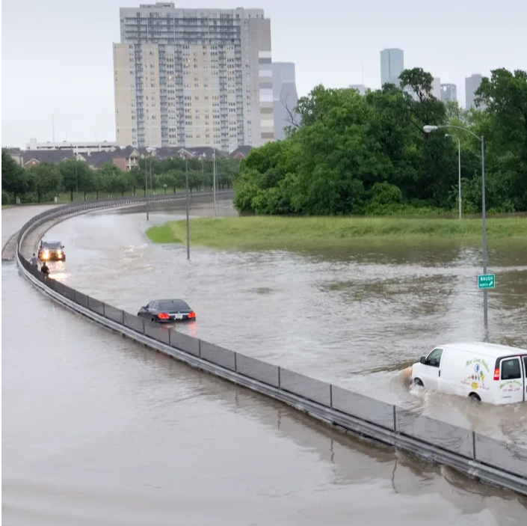
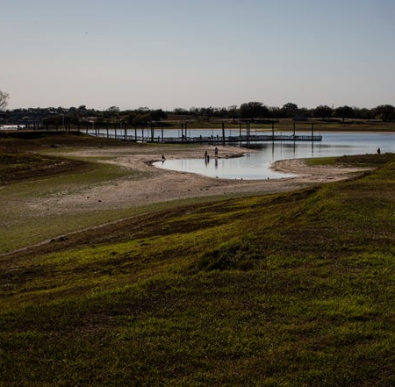
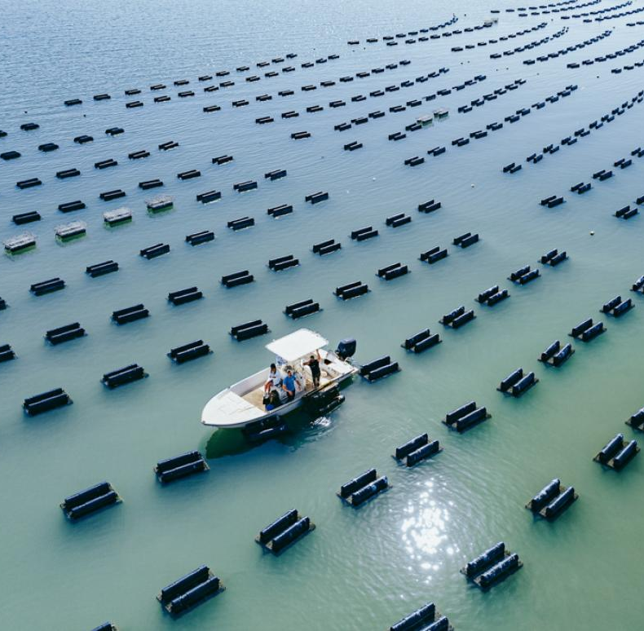
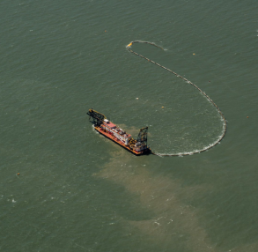
Texas Water Development Board Coastal Science Program
Flooding in Houston: Elliot Blackburn/NOAA
Lake Corpus Christi: Angela Piazza/Caller-Times
Oyster farming: Harte Research Institute
Dredging vessel: Texas GLO
Monitoring & Modeling for Data-Driven Decision Making
Alex Barth (Alex.Barth@twdb.texas.gov)

Slide 3
Texas Water Development Board Mission
Lead the state's efforts in ensuring a secure water future for Texas.
Coastal Science Program
We advance TWDB’s mission through providing high-quality scientific information to stakeholders regarding Texas’s coastal water dynamics. Our legislative directives guide the program to monitor the effects of freshwater inflows upon the bays and estuaries of Texas (§16.012), maintain a continuous study program to determine the conditions necessary to support a sound ecological environment, support environmental flows planning through the 2007 Senate Bill 3 process (§§11.0236– 11.02363), facilitate targeted research studies that support adaptive management of environmental flows (§15.4063), and broadly support water supply planning (§16.051) and coastal flood planning (§16.061). In practice, we meet these objectives through data collection, modeling, analysis, and stakeholder engagement. We additionally directly support the Texas General Land Office’s oil spill response and prevention through providing advanced oil spill trajectory modeling.
Notes:
Section 16.012: determine suitable locations for future water facilities, including reservoir sites;
(2) determine suitable, cost-effective water supply alternatives on a regional basis, including voluntary means of encouraging aggressive water conservation;
(3) locate land best suited for irrigation;
(4) make estimates of the cost of proposed irrigation works and the improvement of reservoir sites;
(5) examine and survey reservoir sites;
(6) monitor the effects of fresh water inflows upon the bays and estuaries of Texas;
(7) monitor instream flows;
(7-a) monitor hydrometeorological conditions;
(8) lead a statewide effort, in coordination with federal, state, and local governments, institutions of higher education, and other interested parties, to develop a network for collecting and disseminating water resource-related information that is sufficient to support assessment of ambient water conditions statewide;
(9) make recommendations for optimizing the efficiency and effectiveness of water resource data collection and dissemination as necessary to ensure that basic water resource data are maintained and available for Texas; and
(10) make basic data and summary information developed under this subsection accessible to state agencies and other interested persons.

Slide 4
Monitoring
Modeling
Researching
Collaborating
Collect data in bays and estuaries through a network of sensors and surveys
Monitor and evaluate the effects of freshwater inflows on estuarine conditions
Support & conduct studies for environmental flow planning
Provide technical information to stakeholders for water and flood planning
Notes:
TWC for specific items:
16.058;
16.012(b)(7)
15.4063
Less directly:16.051,16.061

Slide 6
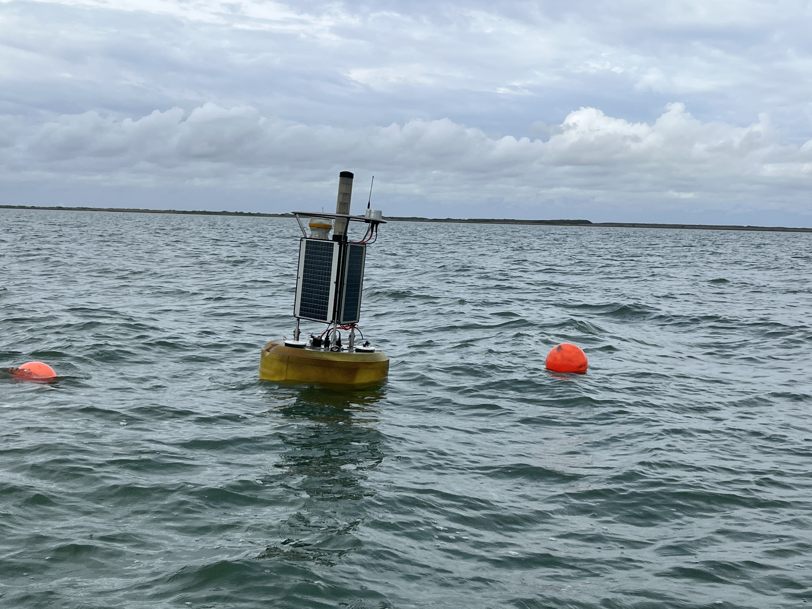
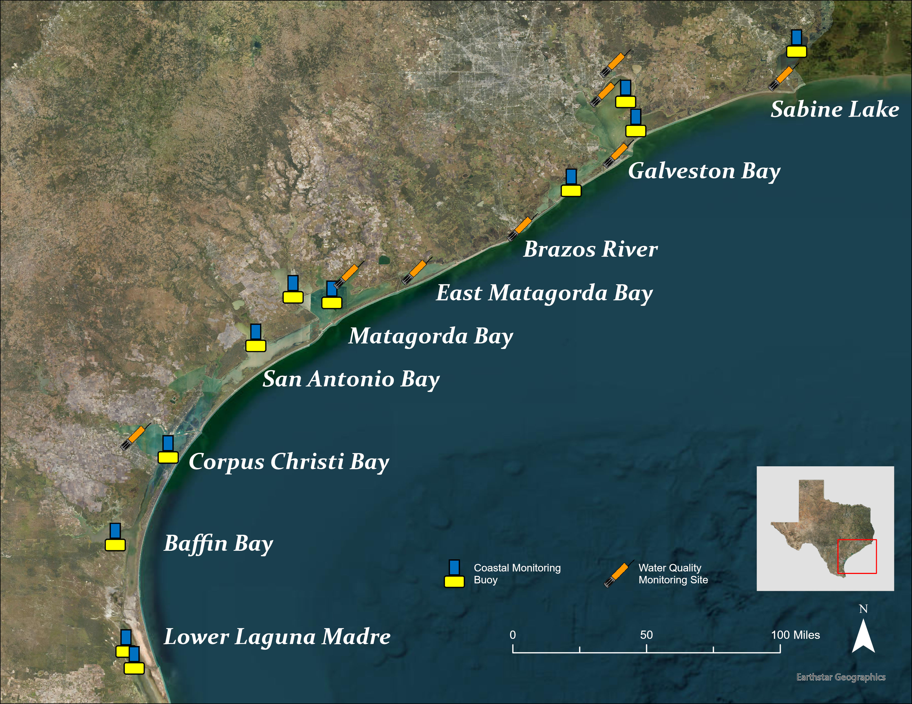
Continuous Water Quality Monitoring
Water Quality Parameters
Temperature
pH
Salinity
Dissolved Oxygen
Chlorophyll-a*
Meteorological Parameters
Temperature
Relative humidity
Precipitation
Air Pressure
Wind (direction/speed)
Global Radiation

Slide 7
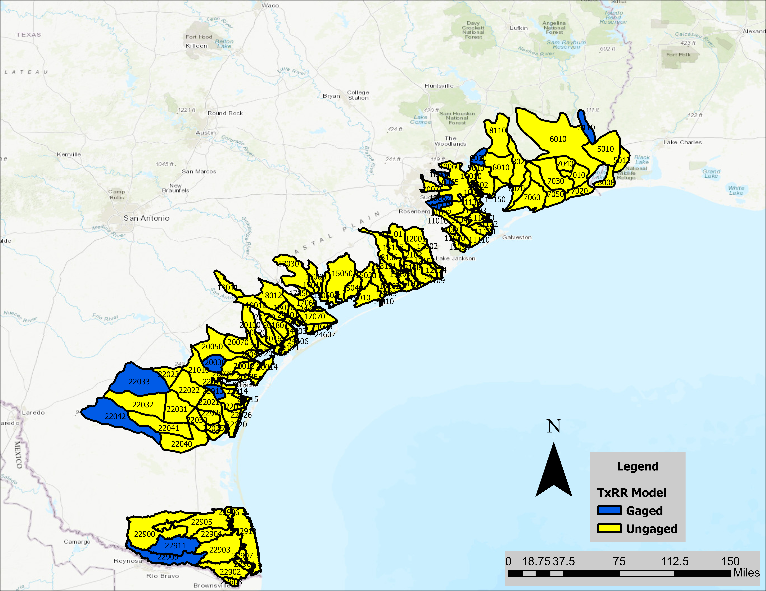
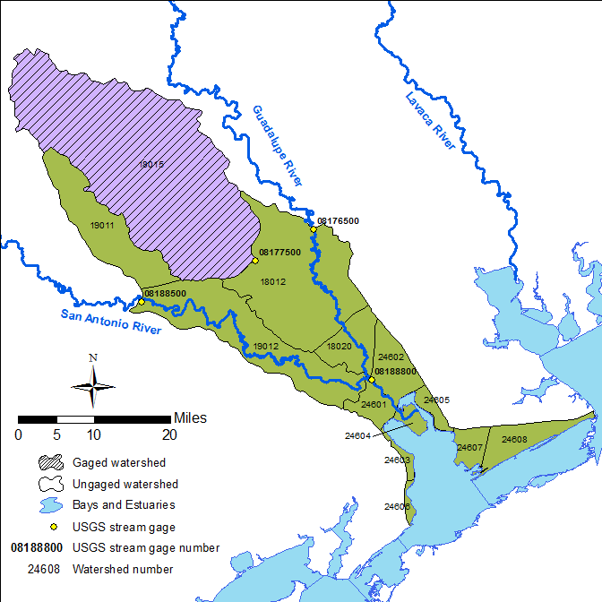
Freshwater Inflow Estimates
Texas Rainfall-Runoff
Hydrologic Models
Gaged Watershed Flows
Ungaged Watershed Flows
+ Modeled
- Diversions
+ Returns
= Surface Inflows to Bay

Slide 8
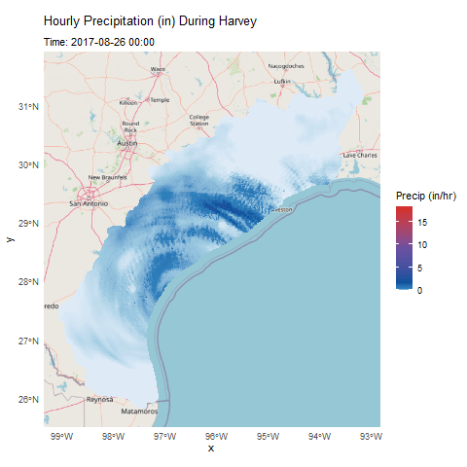
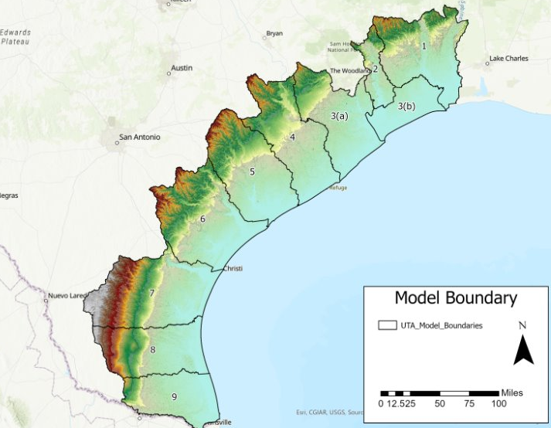
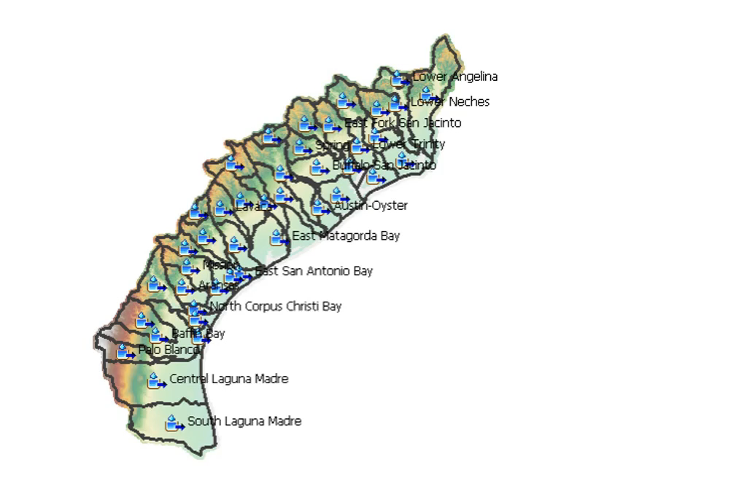
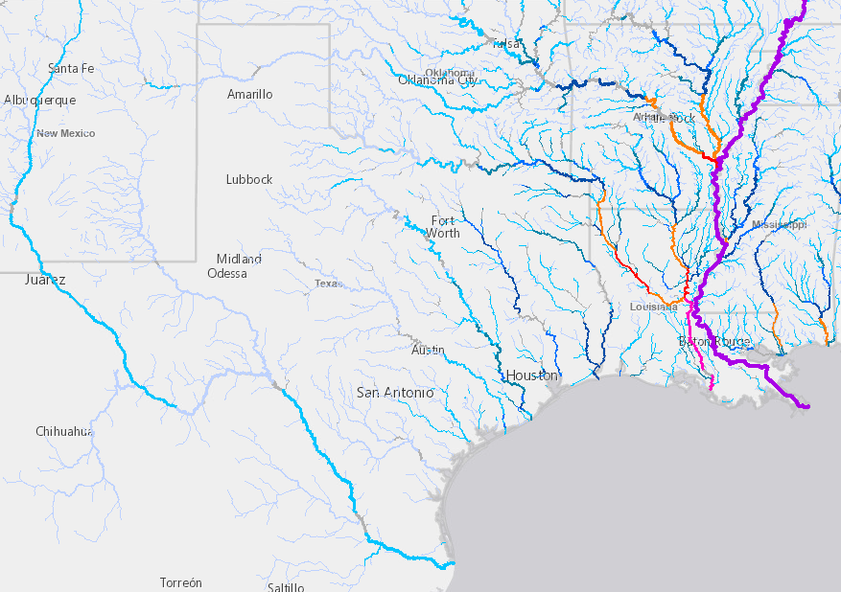




Freshwater Inflow Estimates (upcoming)
Improved Inputs
Improved Models
Developing HEC-HMS models for the coast)
Bias-Corrected Radar Rainfall Product
Ingestion of National Water Model

Slide 9
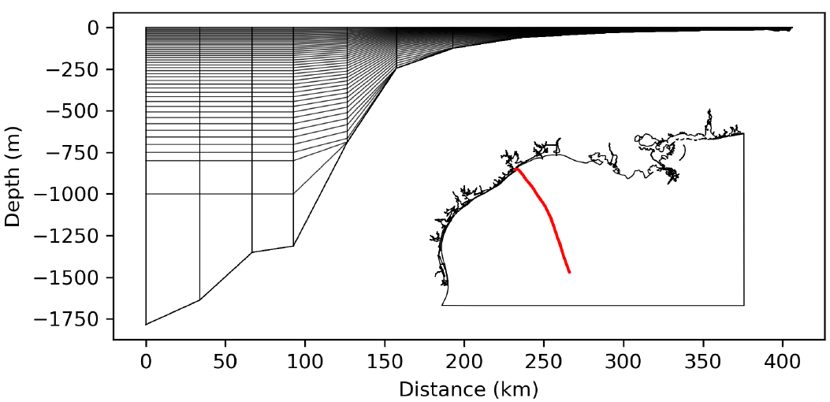
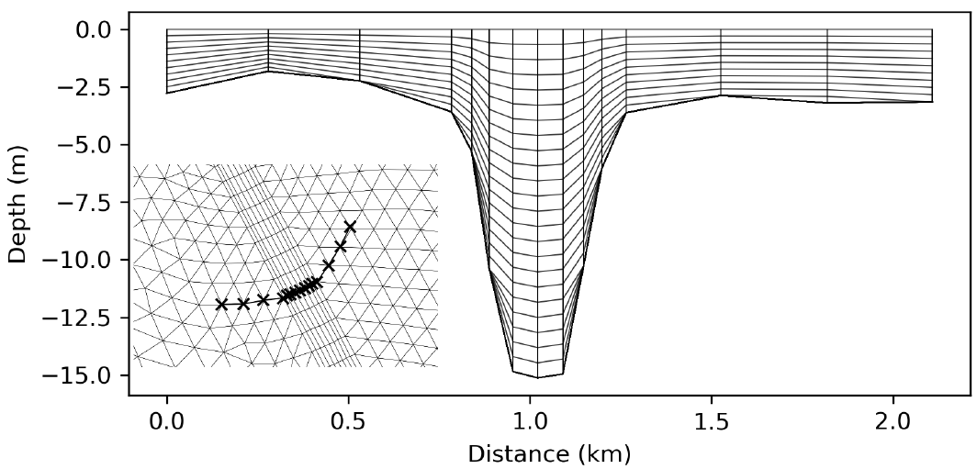


Coastal Hydrodynamics
Finite Element Model (FEM) with 188,395 elements (118,200 nodes)
Horizontal resolution varies from 10km in gulf to ~30m in shipping channels
Vertical resolution varies, with between 10 and 47 layers
Fluvial inflows from 25 largest rivers (USGS gages)
Prediction from National Water Model
Open boundary forced with tidal harmonics and global HYCOM outputs
Meteorology from Global Forecast System (GFS)

Slide 10
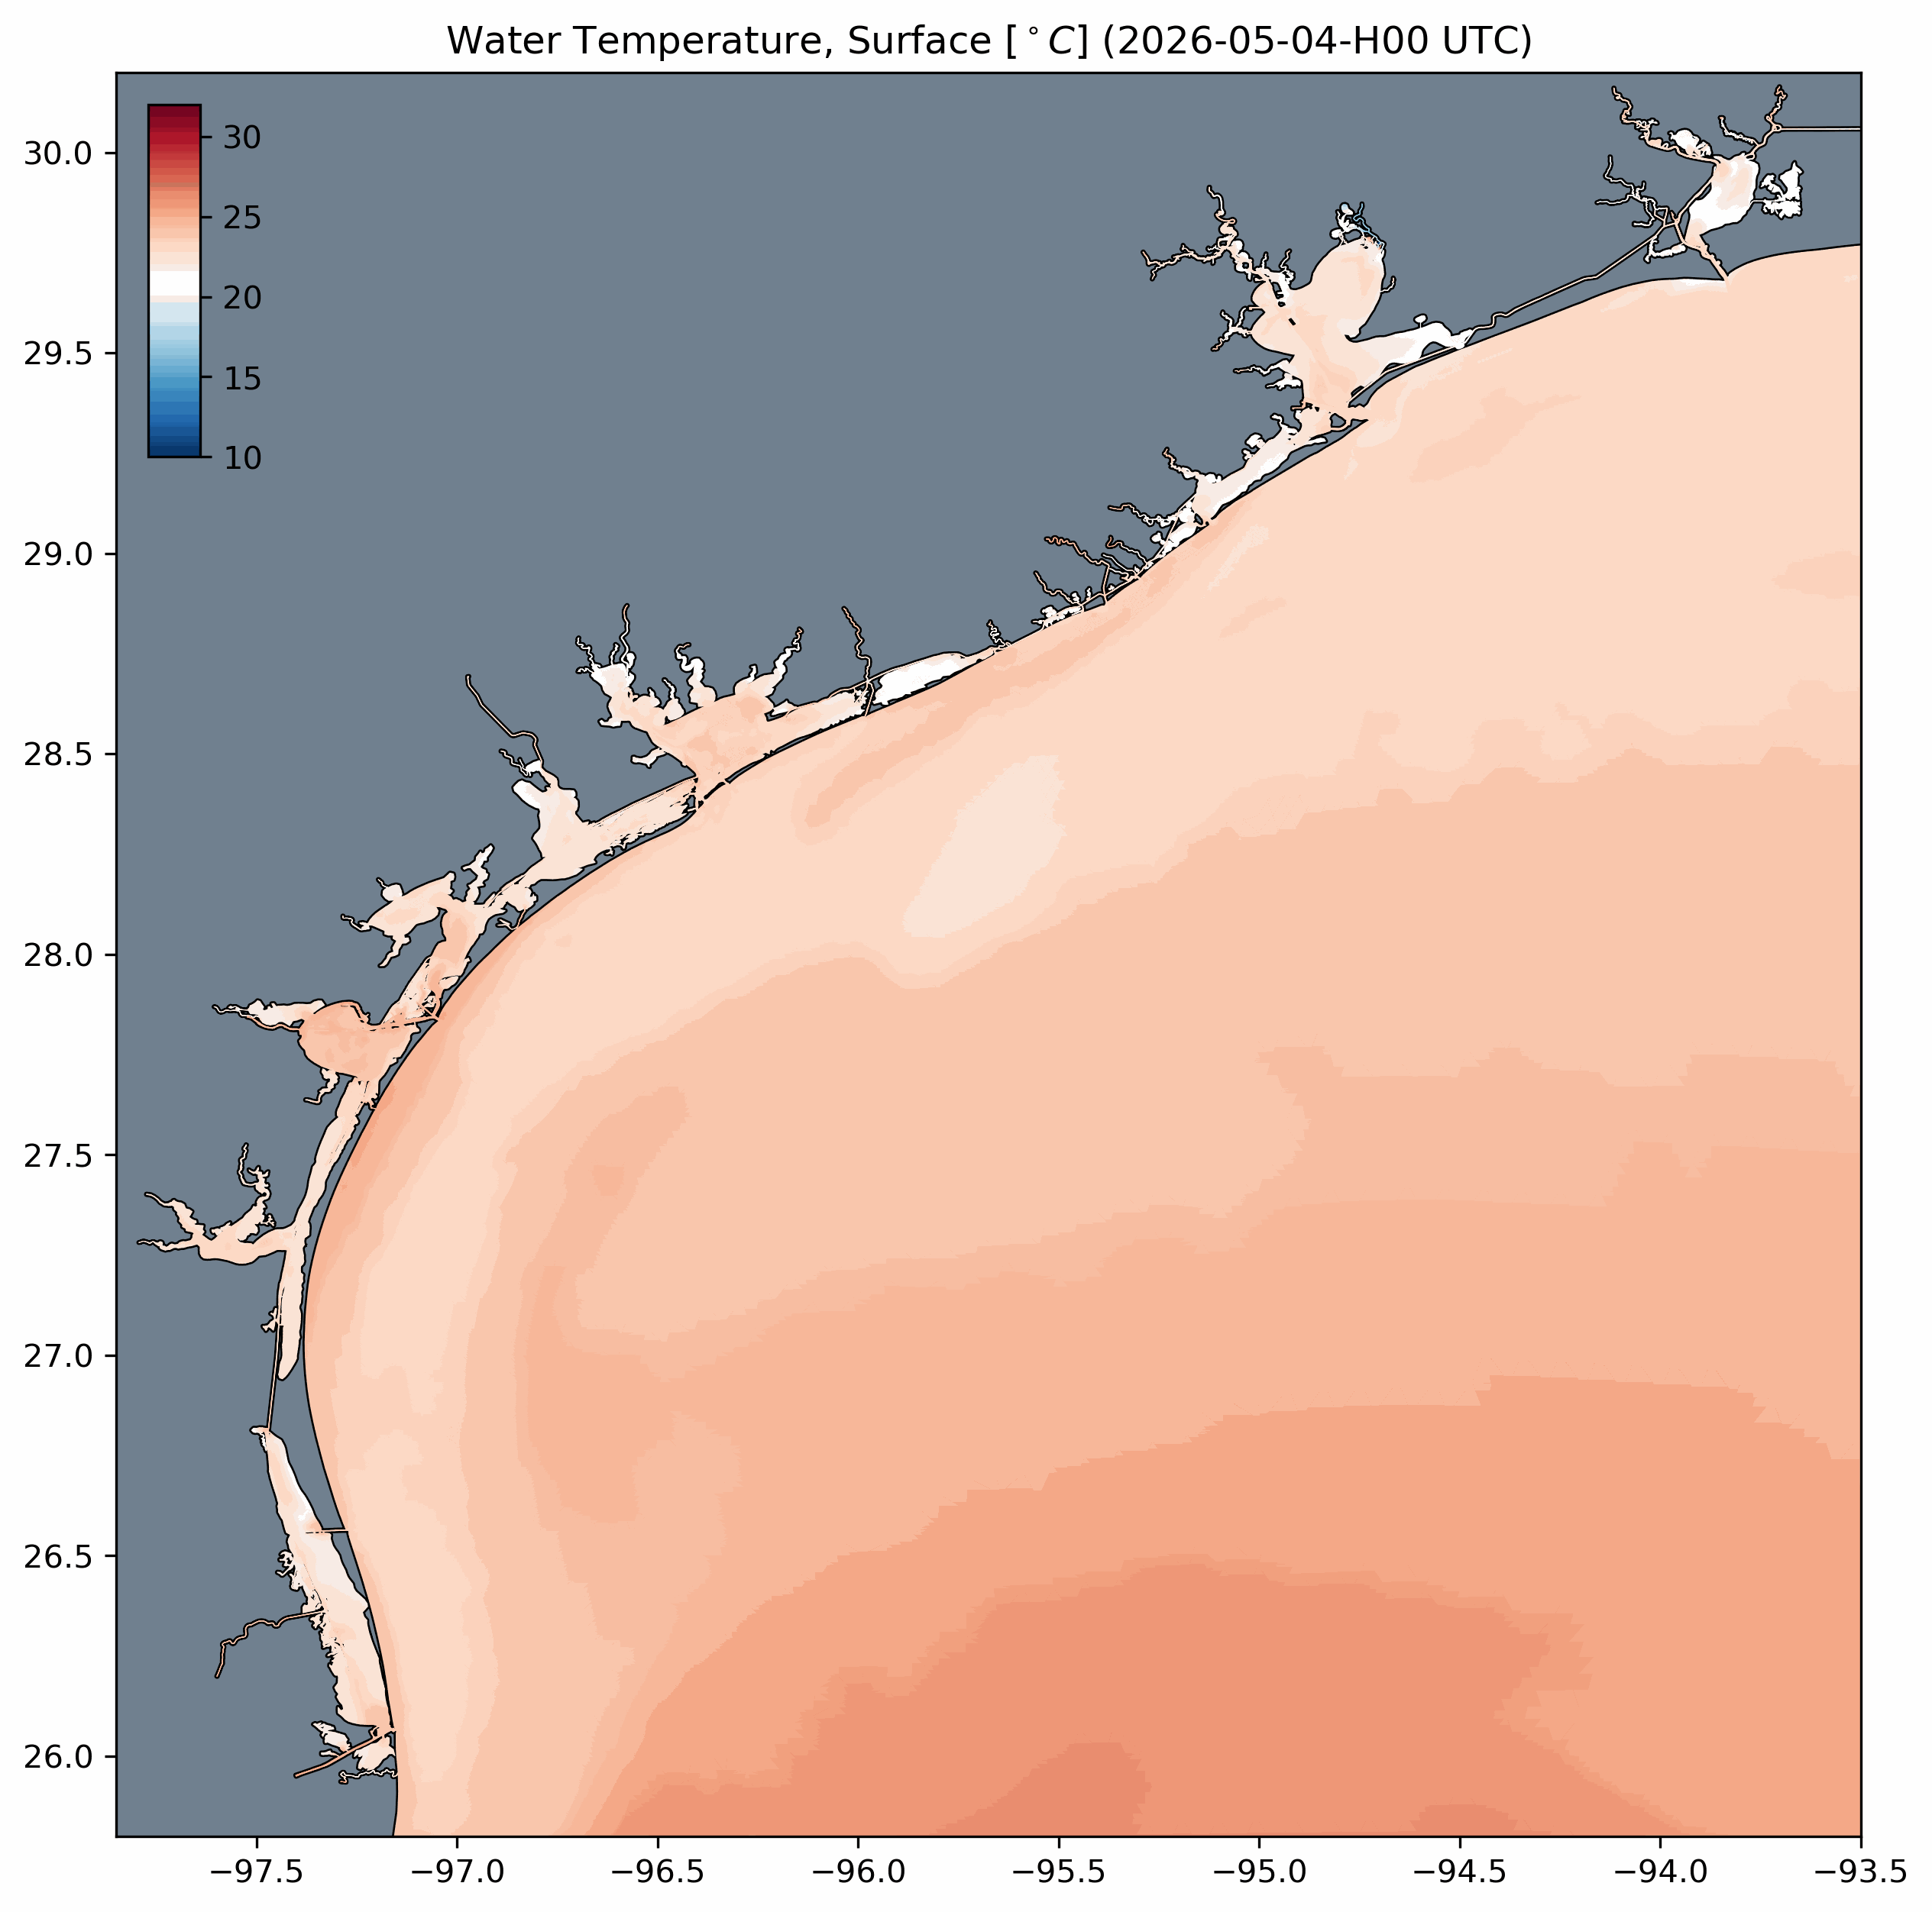
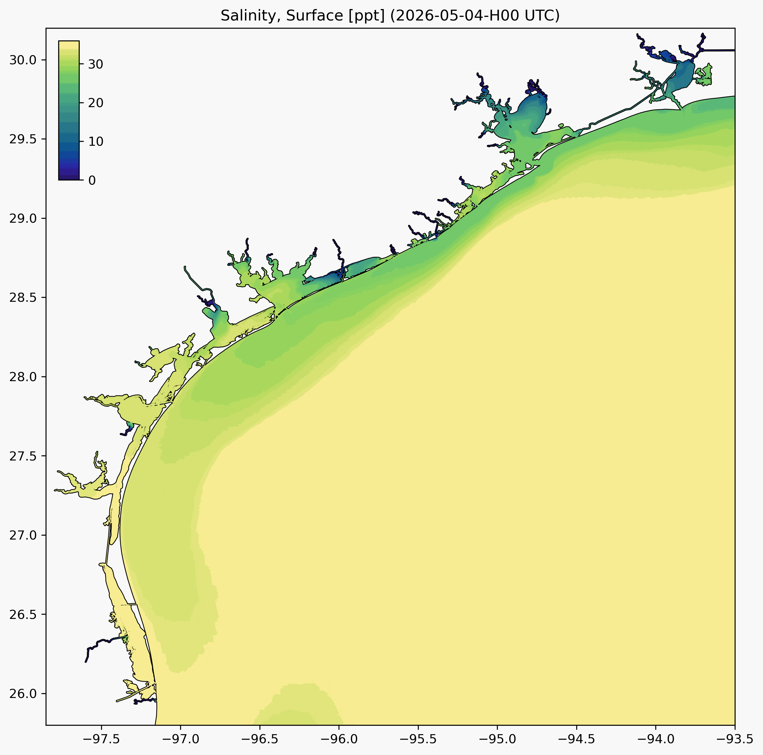
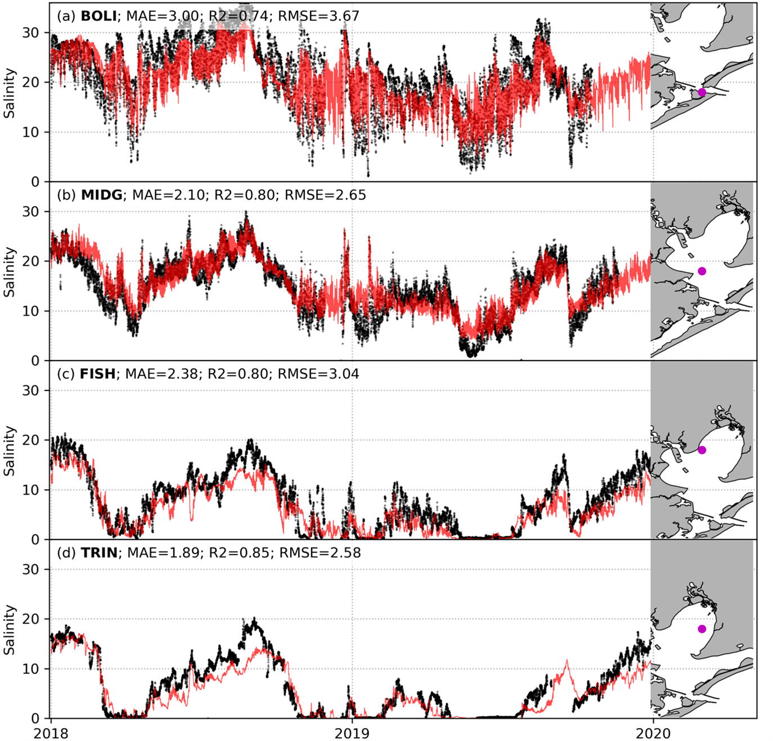
Operational forecast, historical and Scenario-based modeled estimates of temperature, salinity, currents, and water surface elevation
Future extensions for flood inundation and biogeochemistry

Slide 11
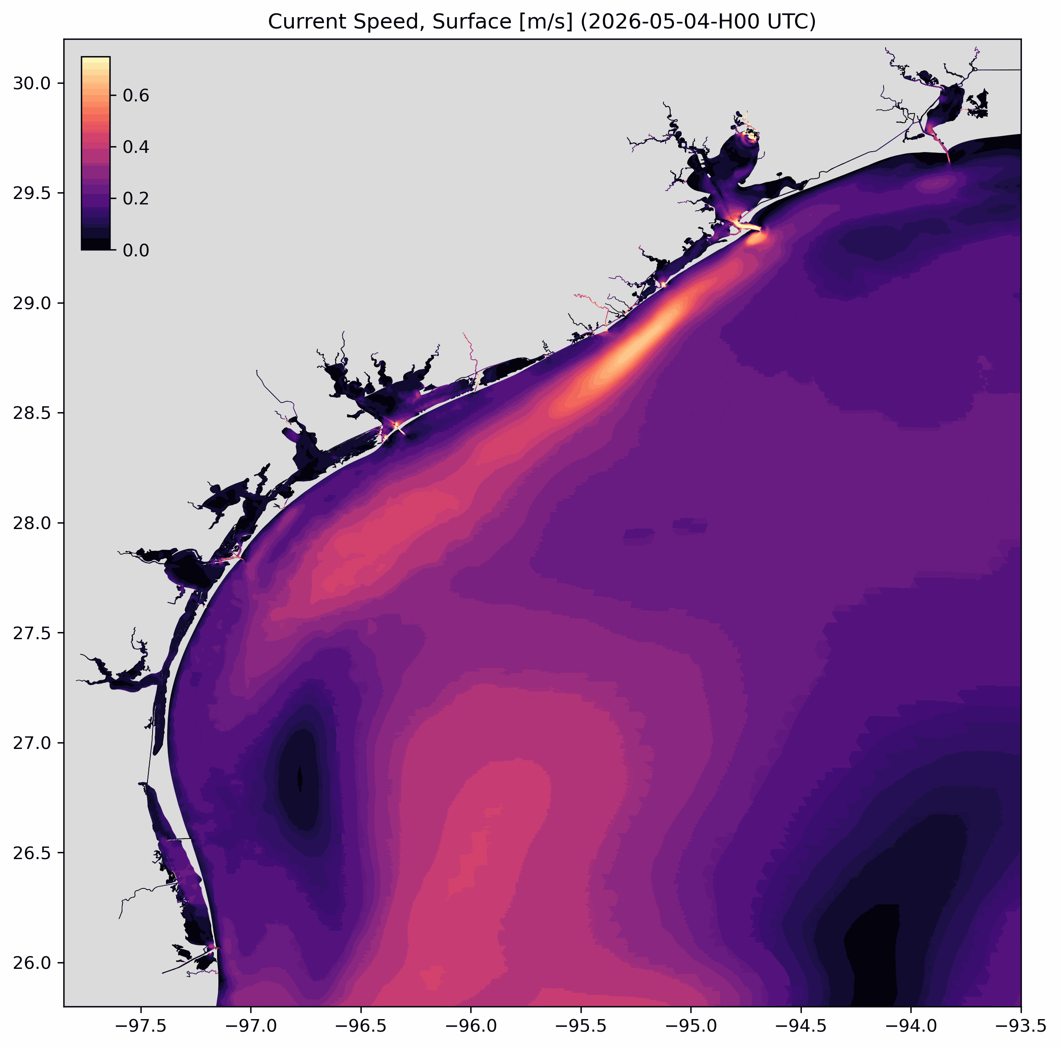
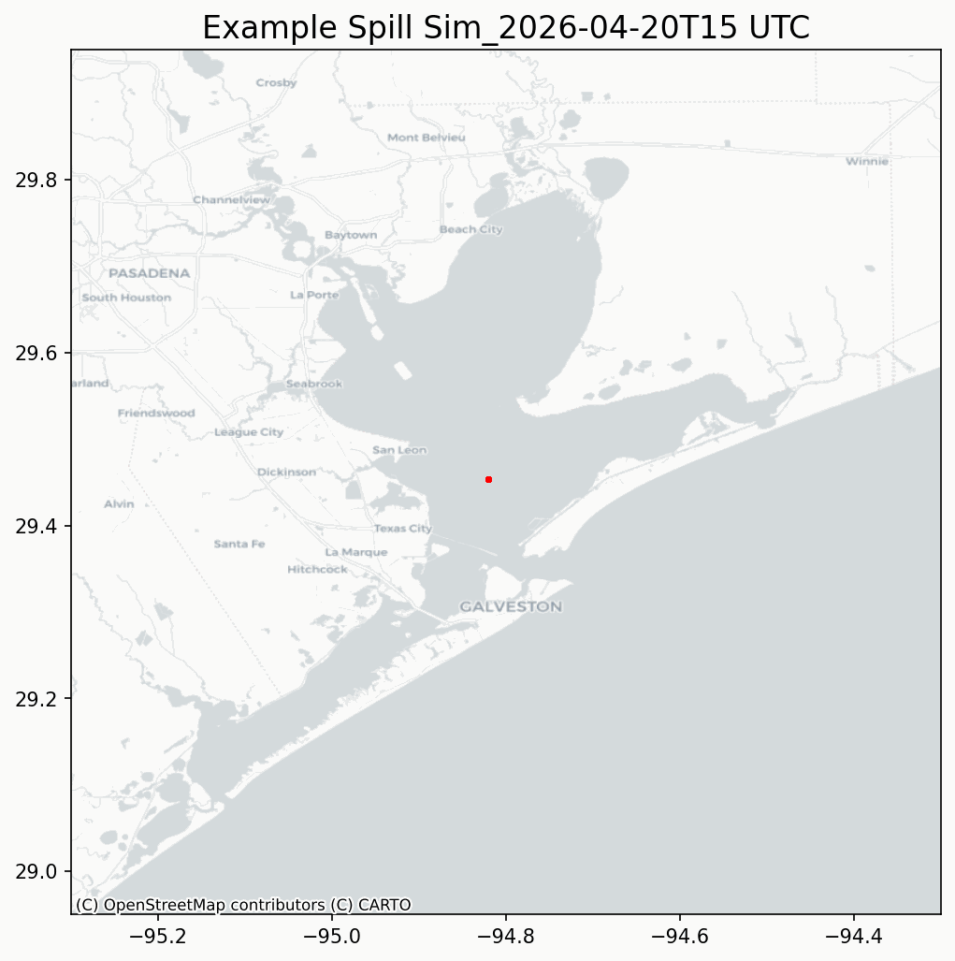

Operational Support for Oil Spill Response

Slide 12
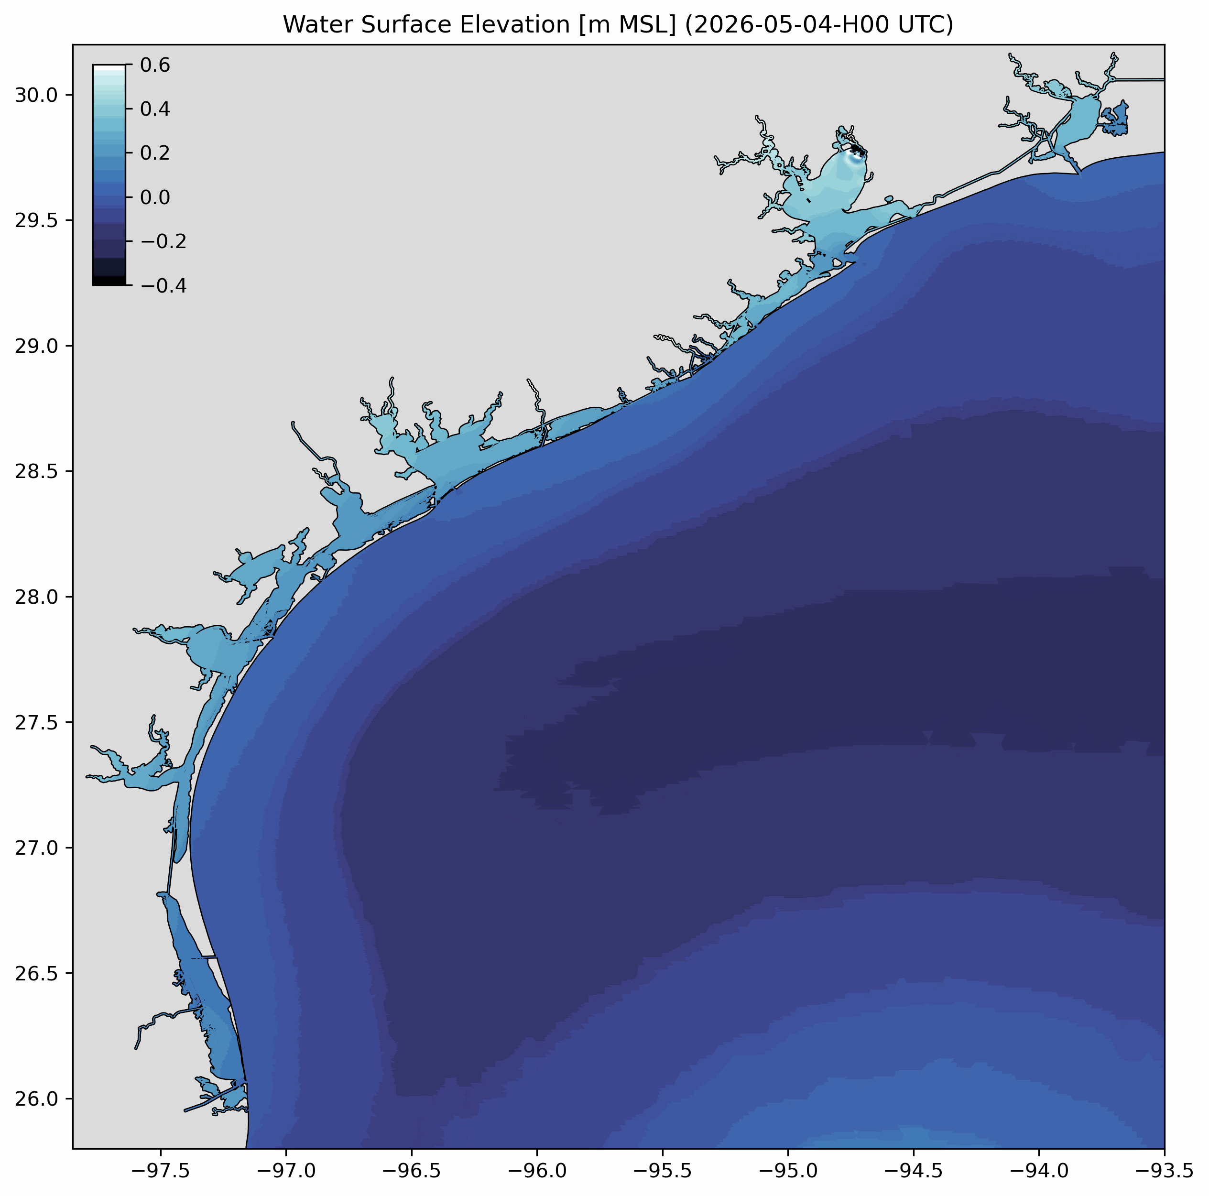

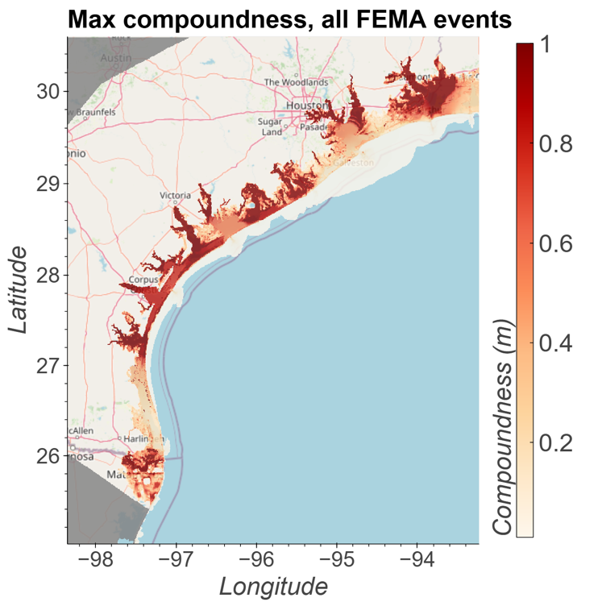
Flood Modeling Support
Extending BAYCAST model for inundation modeling
Compound flood model
ADCRIC (15mil finite elements)

Slide 13
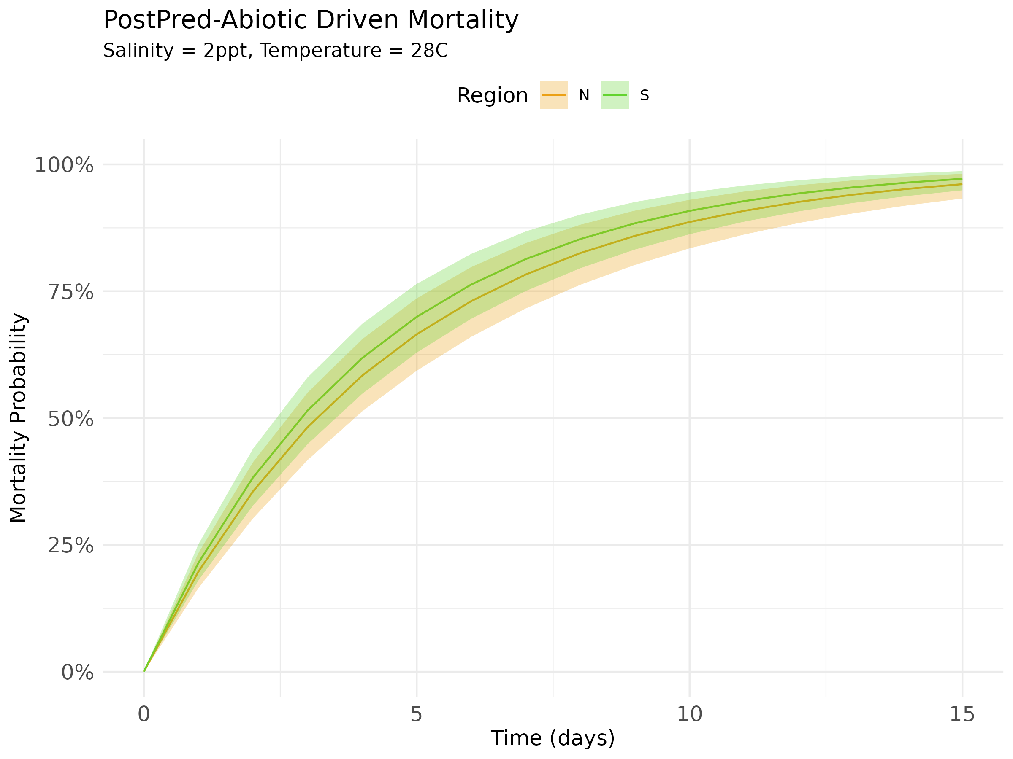
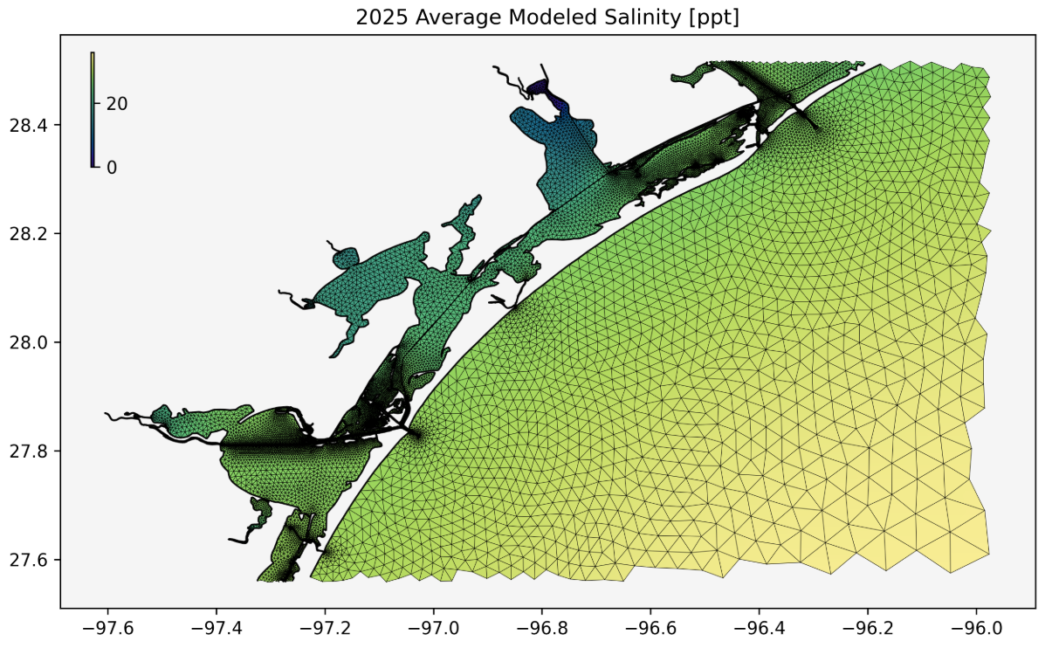
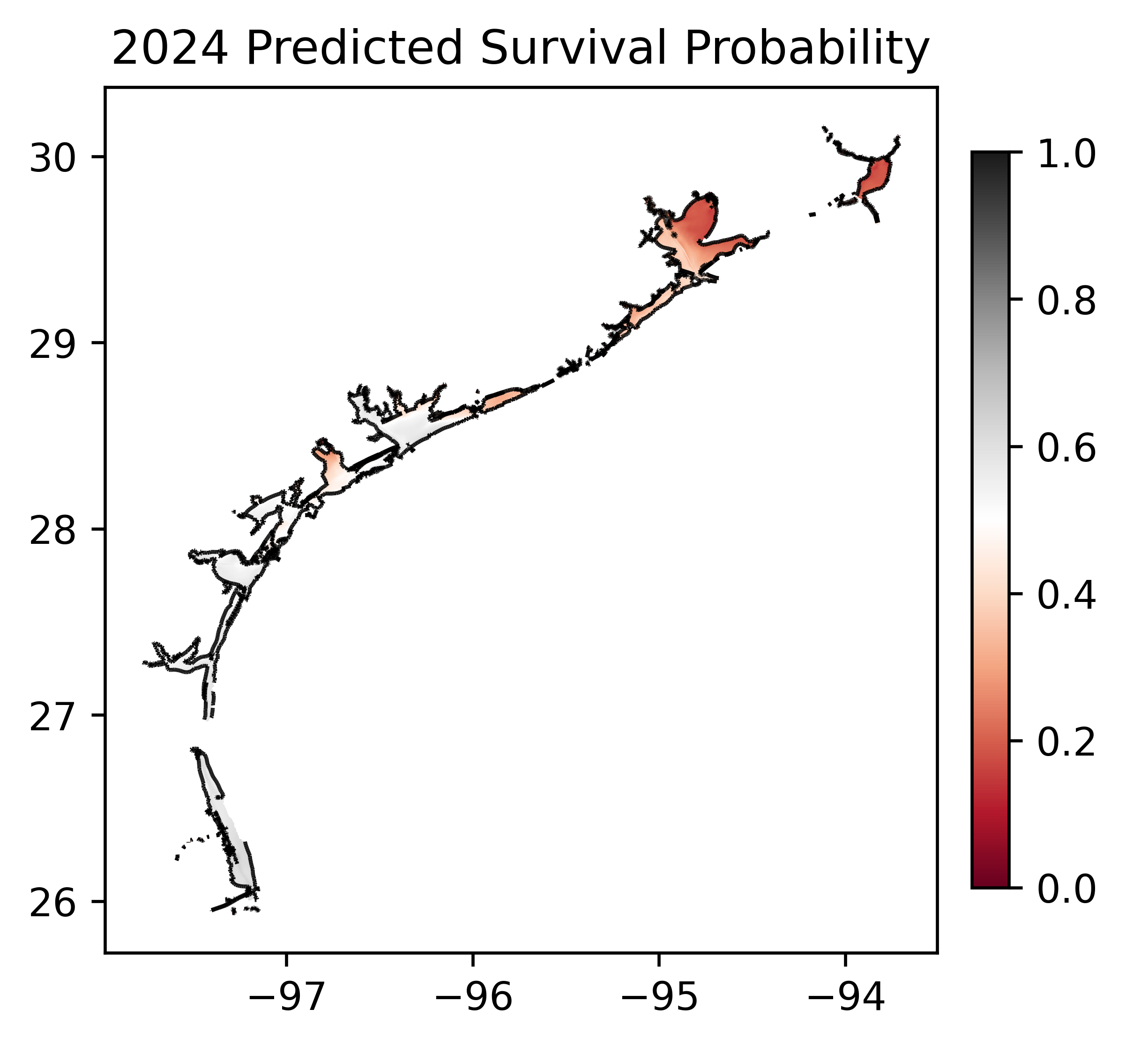
Ecological Modeling Support
Use modeled outputs to inform coastwide ecological decision making
Oyster abiotic mortality risk model

Slide 14
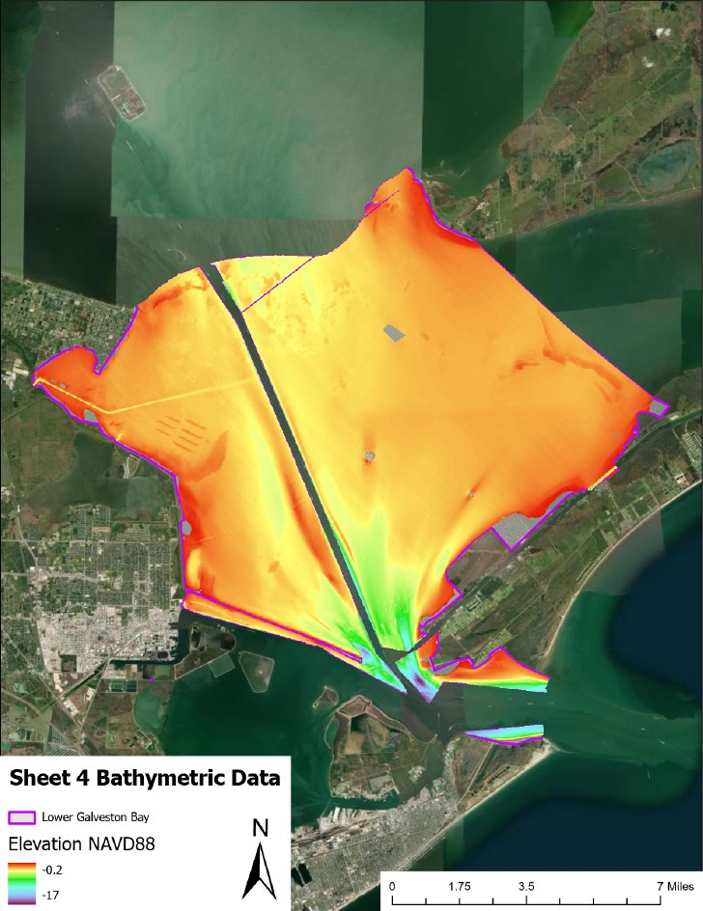
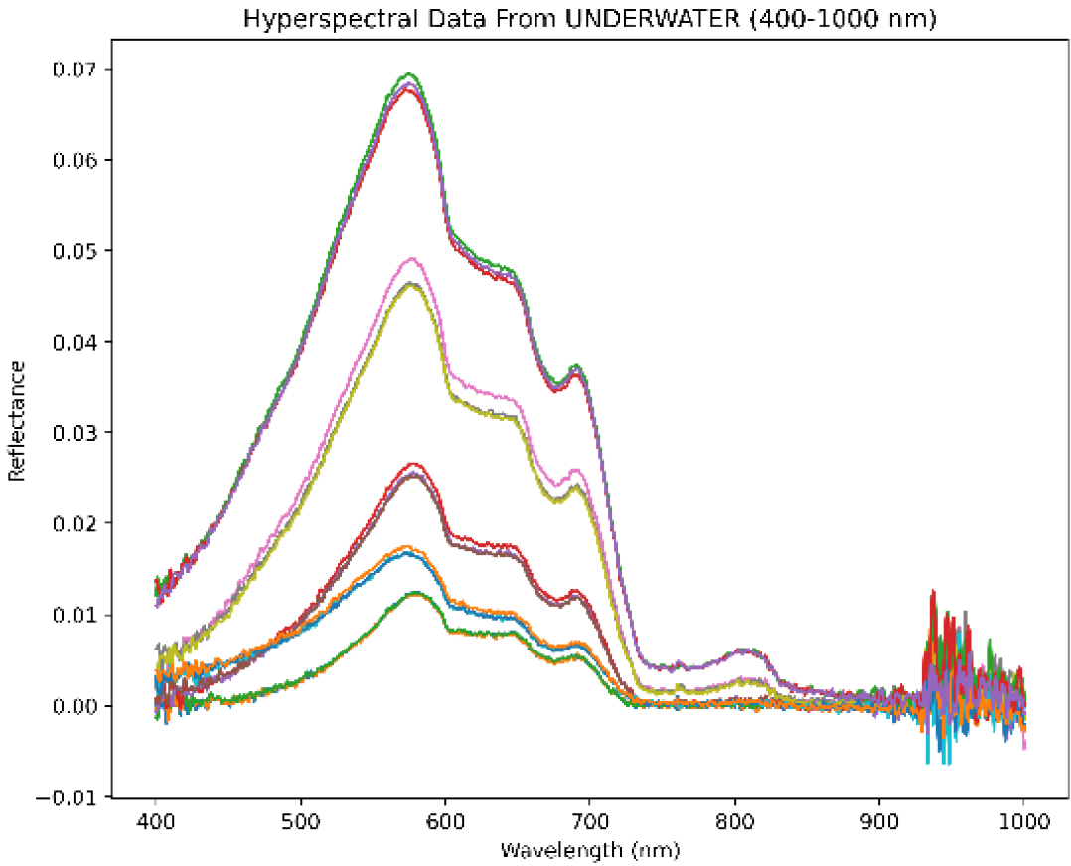
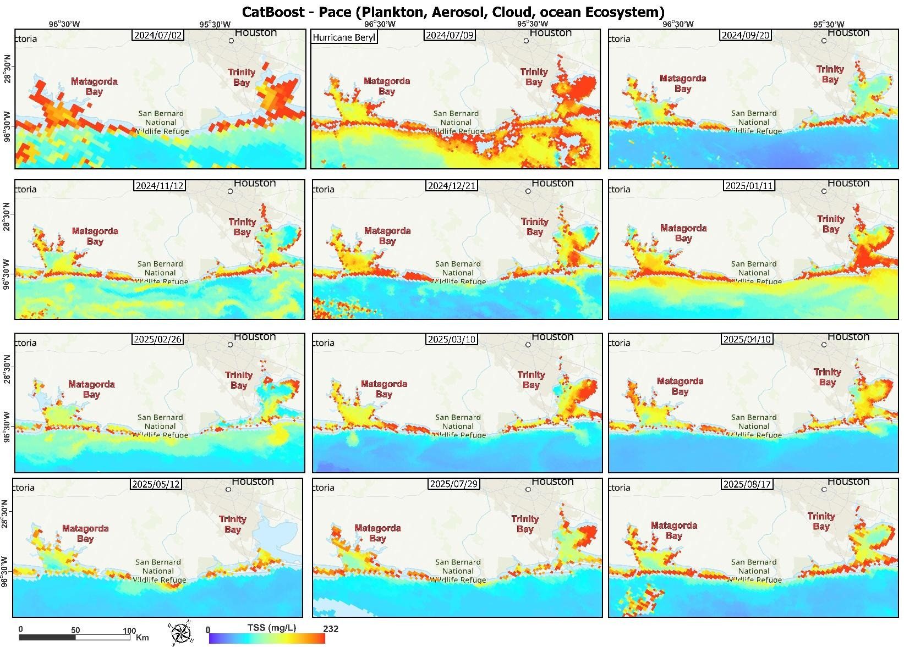

More Data, Improving Models
Several efforts to support increased data for model inputs and program development
Flood-response modeling and mapping
Oil spill identification
Identifying land / bathymetric changes
Subsidence
Sedimentation (Hyperspectral imaging)
Galveston Bay 2023
Karaca et al in review

Slide 15
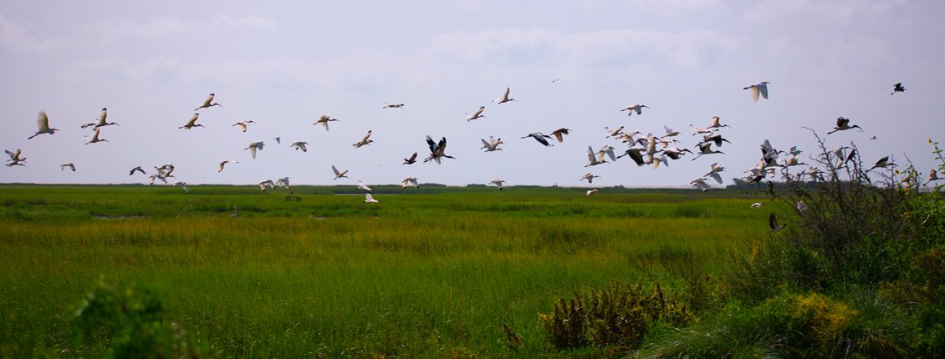
Thanks!
Alex.barth@twdb.Texas.gov

