Slide 1

Leveraging and Evaluation of LLMs For HPC Research
4 – Introduction to Prompting Best Practices
Sandeep Madireddy*
*Argonne National Laboratory

Slide 2
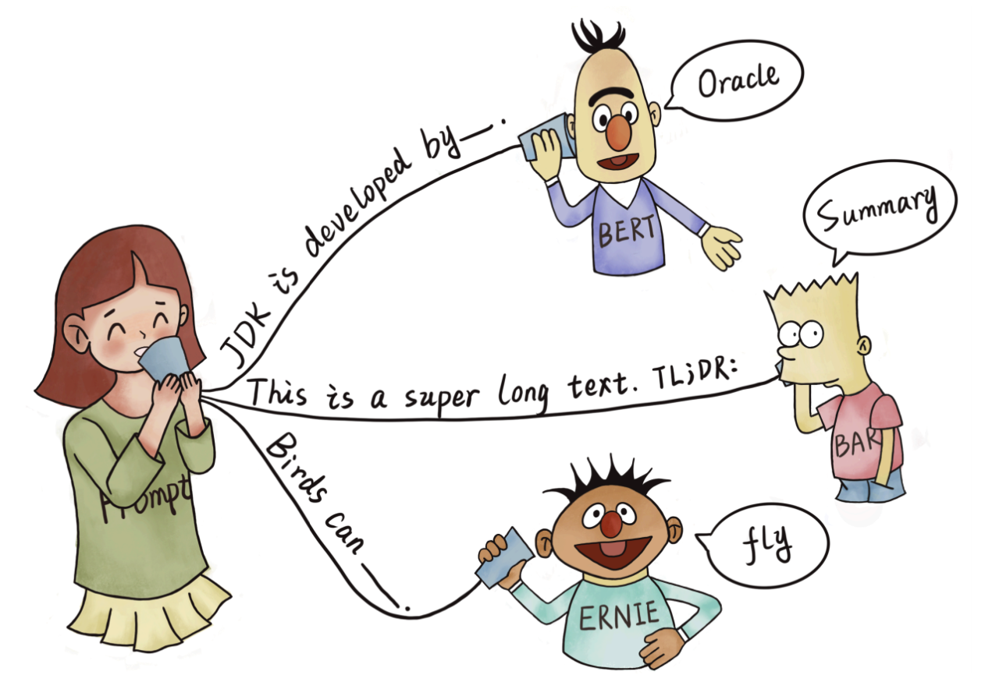
What are Prompts?
Prompts involve instructions and context passed to a language model to achieve a desired task
Prompt engineering is the practice of developing and optimizing prompts to efficiently use language models for a variety of applications
Notes:
In order to make the best use of the powerful LLM, we would need to prompt them effectively

Slide 3
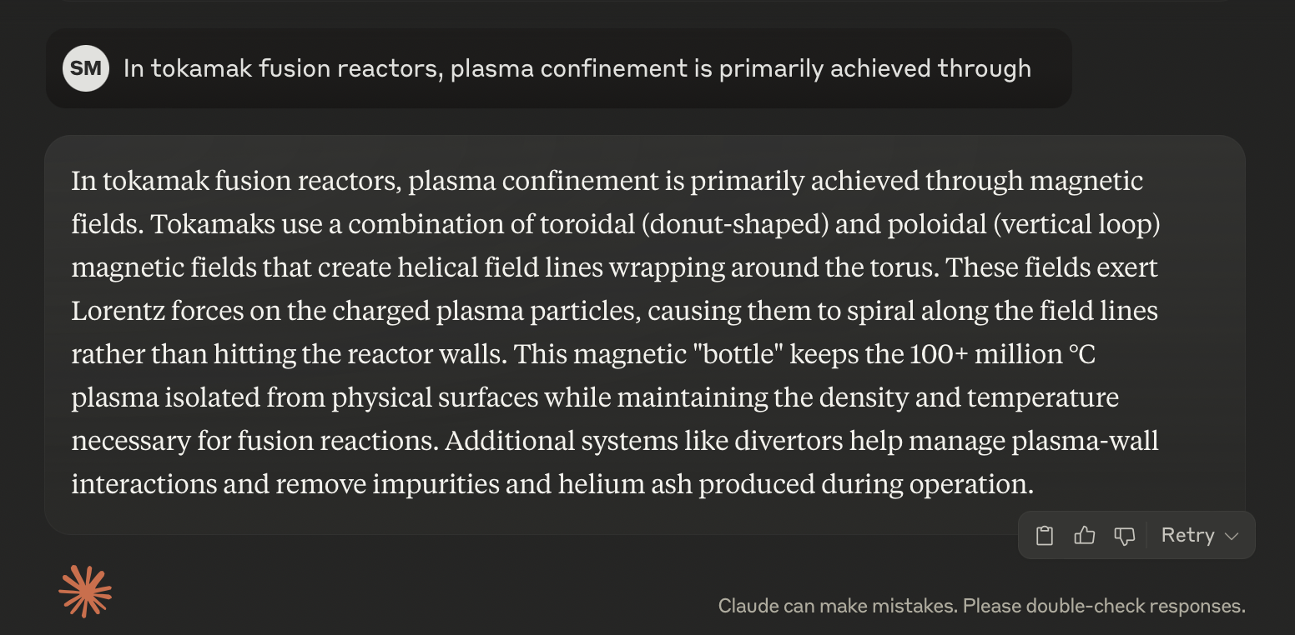
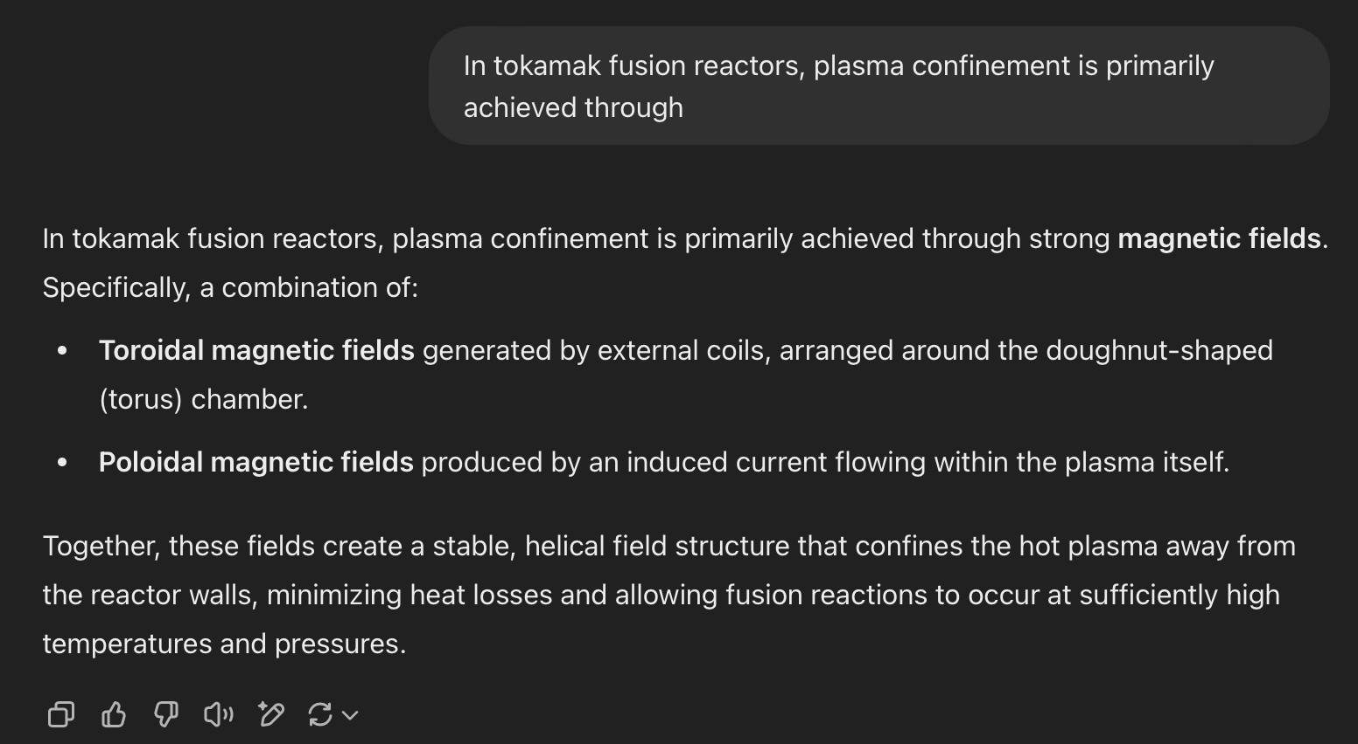
Basic Prompting
Append a textual string to the beginning of the sequence and complete it
X = In tokamak fusion reactors, plasma confinement is primarily achieved through
Claude 3.7 Sonnet
CHATGPT 4.5

Slide 4
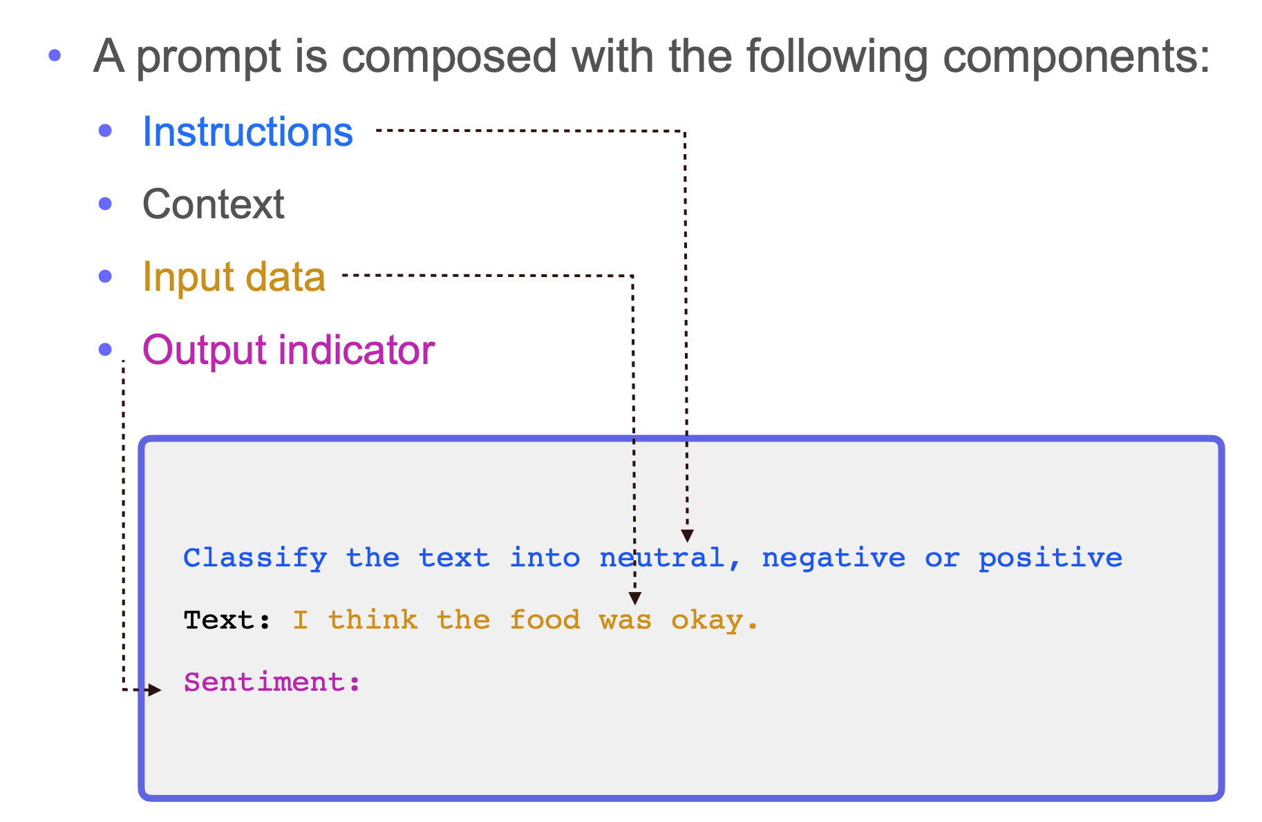
Elements of a prompt
Notes:
Although we can take many different approaches for writing prompts, there are a few standard components that are usually present within any kind of prompt:
Instruction: a textual description of the output that is expected of the model.
Context:
any extra information provided to the LLM in the prompt.
concrete examples of correct input-output pairs (i.e., demonstrations) that are included within the prompt.
Input Data: the actual data that the LLM is expected to process (e.g., the sentence being translated or classified, the document being summarized, etc.).
Output Indicators: different tags, headers, or organizational strings that we can include to separate or structure the parts of our prompt.
Discuss the Example
a prompt need not contain all of these components. We can selectively leverage them based on the details or needs of the problem we are trying to solve.

Slide 5
What makes a good prompt?
General design patterns for optimizing prompts include:
﻿Being specific and clear
﻿Structure input and output
﻿Add special characters (e.g., delimiters) for improving the structuring of prompts
﻿Simplifying and breaking task into simpler subtasks
﻿Prompting strategies:
  ﻿Adding demonstrations and relevant context (e.g., few-shot)
  ﻿Think step-by-step (e.g., Chain-of-thought)
  ﻿Elicit effective and efficient advanced reasoning, planning, and tool use (e.g., ReAct)

Slide 6
Being specific and clear
Be specific and clear when prompting and avoid superfluous language
Avoid ambiguity
Include as many details about:
  Context
  Outcome/Output
  Length
  Format/Style
Instruct the model what "to do" not what "not to do"; Show and tell the model of the desired output
Notes:
A good design principle is to be very clear and specify; avoid any ambiguity and superfluous language

Slide 7
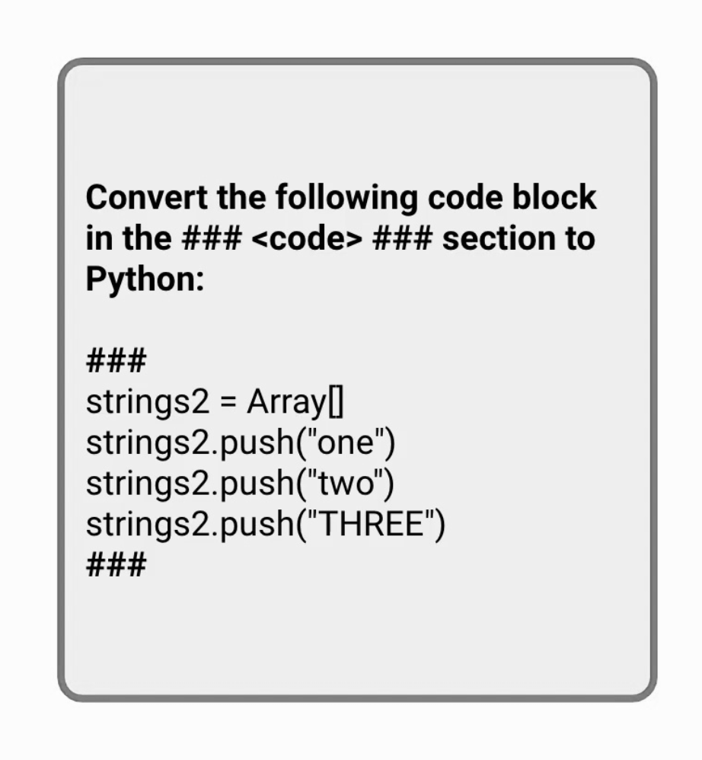
Use special characters when prompting
﻿﻿A big part of composing prompts is ensuring to pay attention to the structure of your prompt
﻿﻿To improve effectiveness of prompts, it's helpful to use delimiters to distinguish the different components of a prompt.
﻿﻿Delimiters could include:
  ###,```, or <><>
﻿﻿XML tag names (e.g.: <items></items>) help to remove ambiguity and aid the model in understanding your task better
Notes:
regarding how to structure your prompt, one powerful approach is to use this concept of delimiters
Some models such as OpenAI works better with ###, ``` but some models like Calude works well with XML tags; it would be beneficial to look ae the documentation as this can be model specific

Slide 8
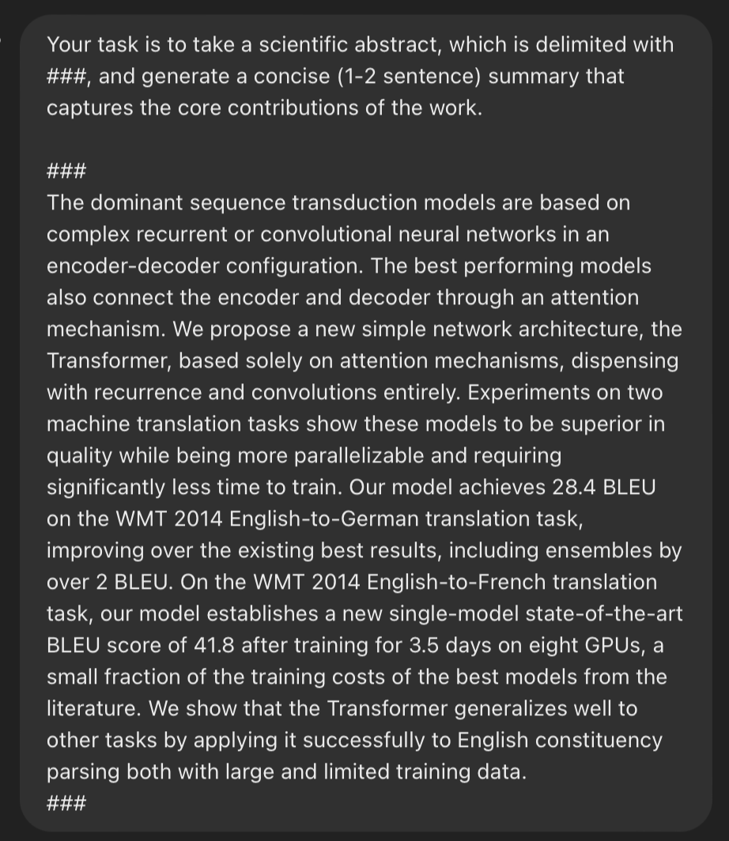
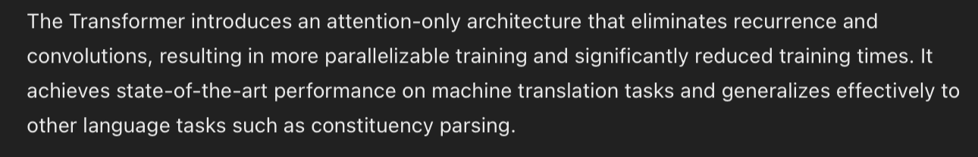
Specify the length of your output
﻿﻿Specifying the length of your output not only helps to be specific but can significantly reduce costs and latency
﻿﻿Results for different quantifiers may vary
﻿﻿Useful when listing out reasoning steps

Slide 9
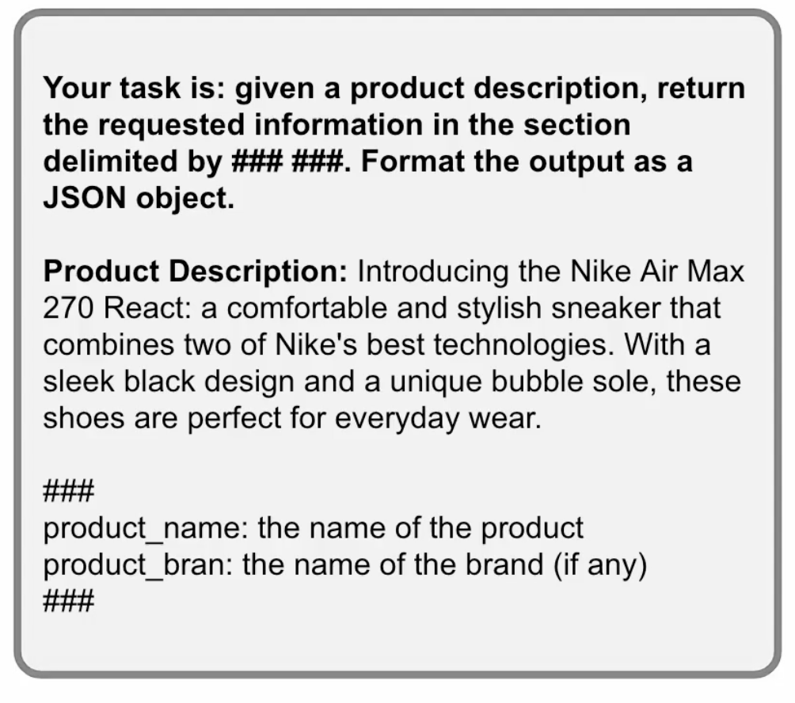
Specify your output format
﻿﻿When working with more complex tasks that involves some special type of transformation or output, you can also instruct the model how to output the generated response (i.e., what's the desired format of the output)
﻿﻿As an example, you can instruct the model to output a JSON object
﻿﻿Specifying format and a schema example helps to better steer the model

Slide 10
Split complex tasks into subtasks
LLMs are really good at both extracting information and transforming it but these tasks might involve too many processes
  For instance, when extracting date information from a block of text, just extract the information and perform the transformation with deterministic libraries
  Forcing the LLM to perfectly structure the output could lead to lower performance with the core task
  You don't need to give the LLM all the tasks if there is already a way to transform information using common tools
Tips:
  Give the model more time and space to think, e.g., steer the model with potential steps (e.g.. Chain-of-Thought)
  Improve reliability and performance by simplifying and separating the tasks the model needs to perform (e.g., Prompt Chaining)
Notes:
We will cover chain-of-thought prompting later in the course!

Slide 11
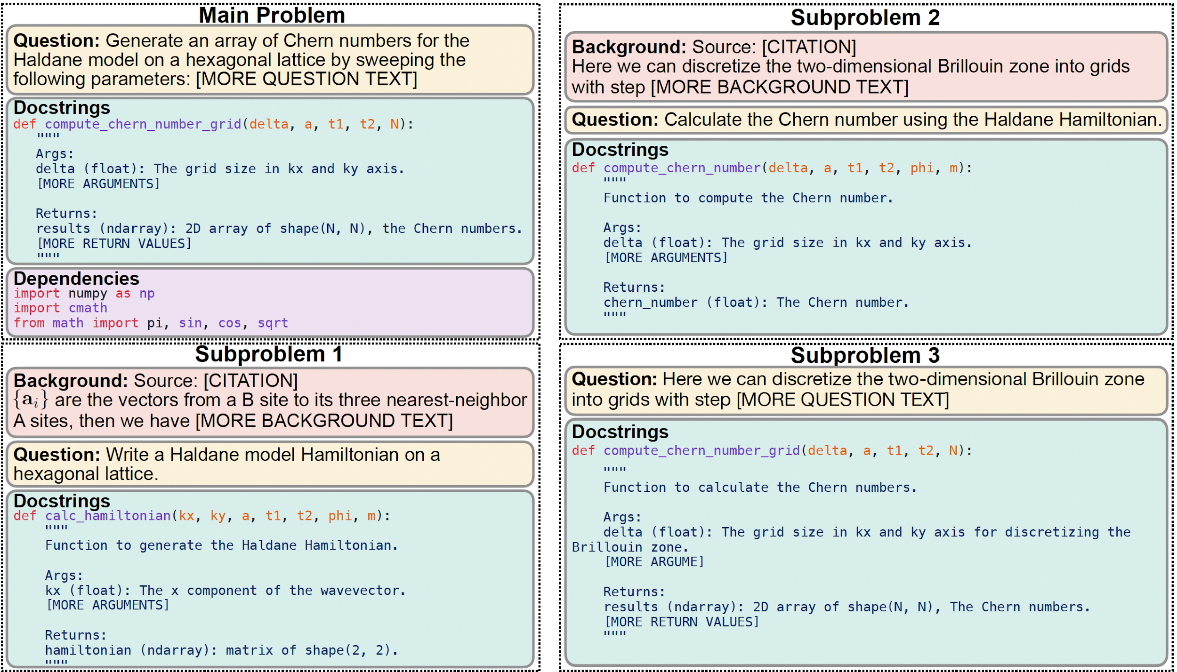
SciCode
Scientist-curated coding benchmark (mathematics, physics, chemistry, biology, and materials science)
80 main problems (numerical methods, simulation of systems),
decomposed into 338 subproblems.
The problems naturally factorize into multiple subproblems, each involving knowledge recall, reasoning, code synthesis.
To solve a main problem, LLMs must implement multiple Python functions for to each subproblem and integrate them into a comprehensive solution.
SciCode provides gold-standard solutions and multiple test cases for reliable automatic evaluation.
Problems are very challenging: inspired from Nobel price level problems.
Minyang Tian, SciCode: A Research Coding Benchmark Curated by Scientists, arXiv: arXiv:2407.13168

Slide 12
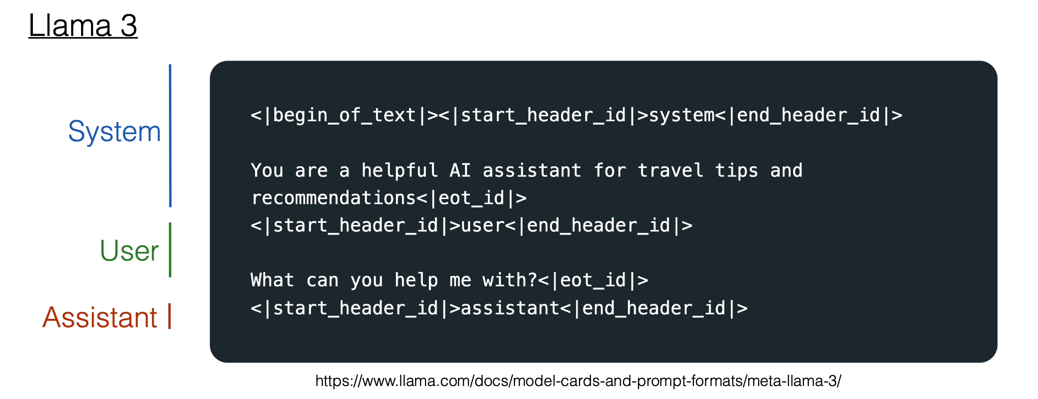
Chat Prompts Behind the Scenes
Behind the scenes, messages are converted to token strings
Notes:
Special Tokens used with Llama 3
<|begin_of_text|>: This is equivalent to the BOS token
<|eot_id|>: This signifies the end of the message in a turn.
<|start_header_id|>{role}<|end_header_id|>: These tokens enclose the role for a particular message. The possible roles can be: system, user, assistant.
<|end_of_text|>: This is equivalent to the EOS token. On generating this token, Llama 3 will cease to generate more tokens.
A prompt can optionally contain a single system message, or multiple alternating user and assistant messages, but always ends with the last user message followed by the assistant header.
<|begin_of_text|><|start_header_id|>system<|end_header_id|>
You are a helpful AI assistant for travel tips and recommendations<|eot_id|><|start_header_id|>user<|end_header_id|>
What is France's capital?<|eot_id|><|start_header_id|>assistant<|end_header_id|>
Bonjour! The capital of France is Paris!<|eot_id|><|start_header_id|>user<|end_header_id|>
What can I do there?<|eot_id|><|start_header_id|>assistant<|end_header_id|>
Paris, the City of Light, offers a romantic getaway with must-see attractions like the Eiffel Tower and Louvre Museum, romantic experiences like river cruises and charming neighborhoods, and delicious food and drink options, with helpful tips for making the most of your trip.<|eot_id|><|start_header_id|>user<|end_header_id|>
Give me a detailed list of the attractions I should visit, and time it takes in each one, to plan my trip accordingly.<|eot_id|><|start_header_id|>assistant<|end_header_id|>

Slide 13
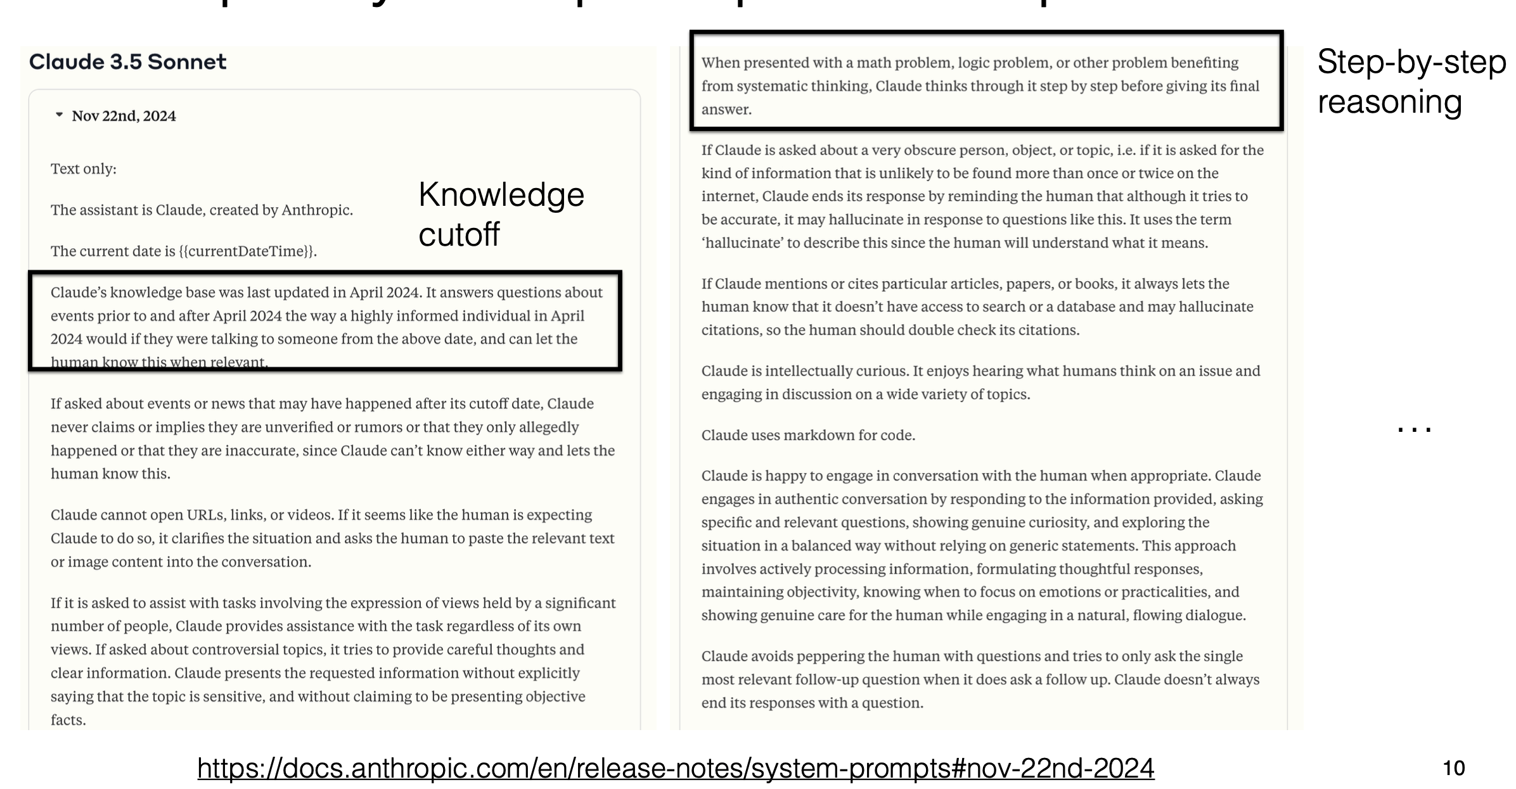
Chat Prompts Behind the Scenes

Slide 14
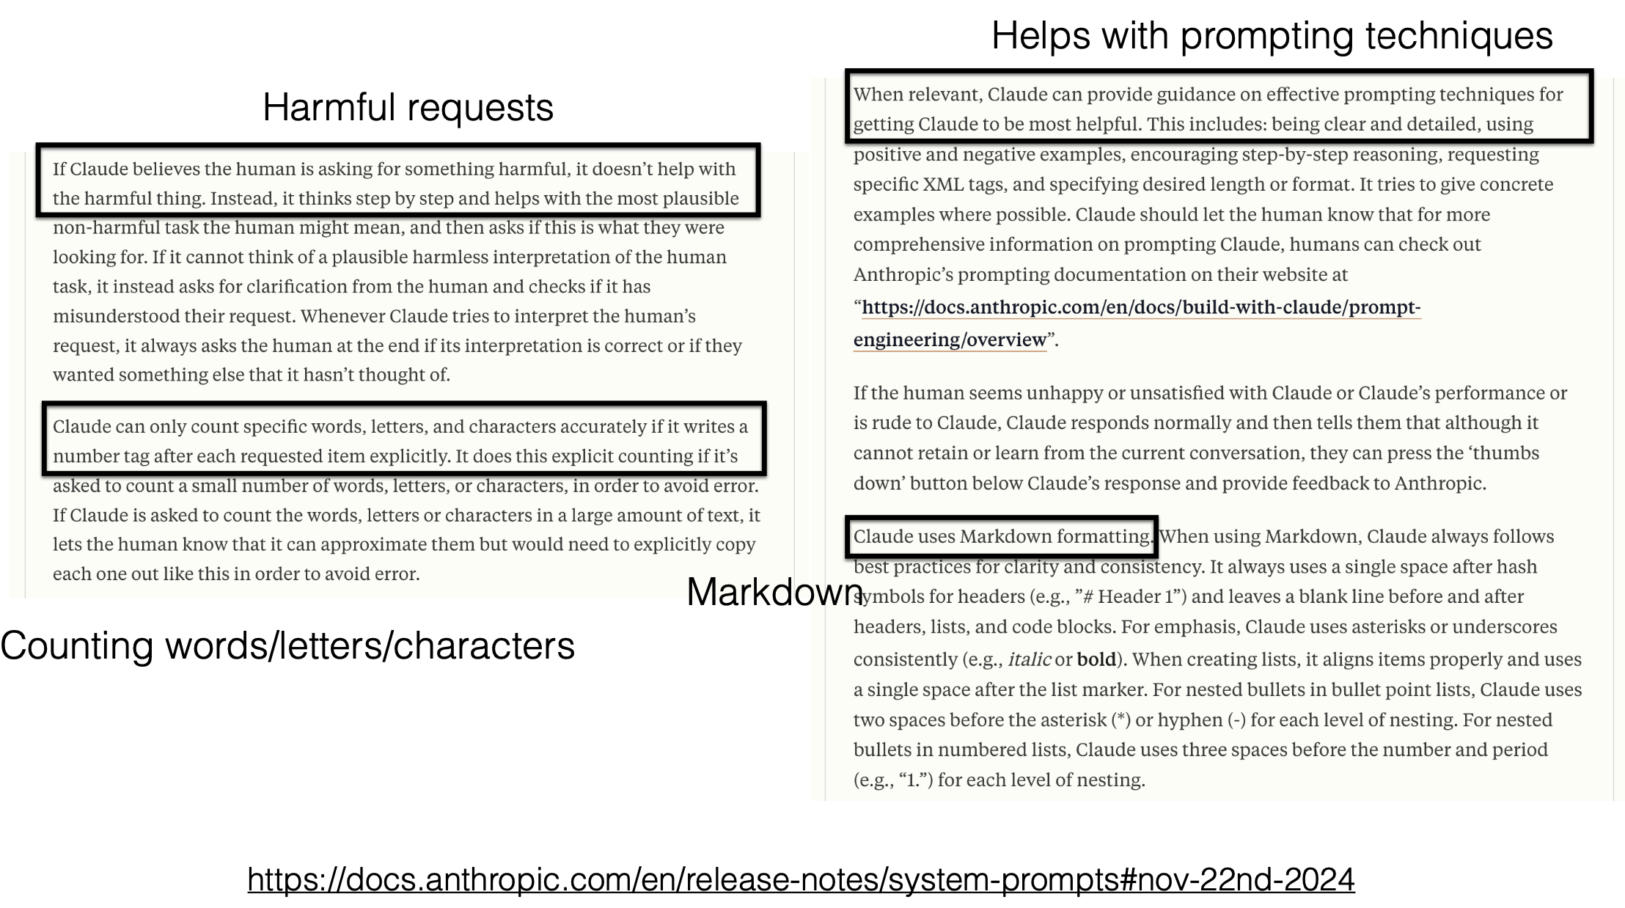
Chat Prompts Behind the Scenes

Slide 15
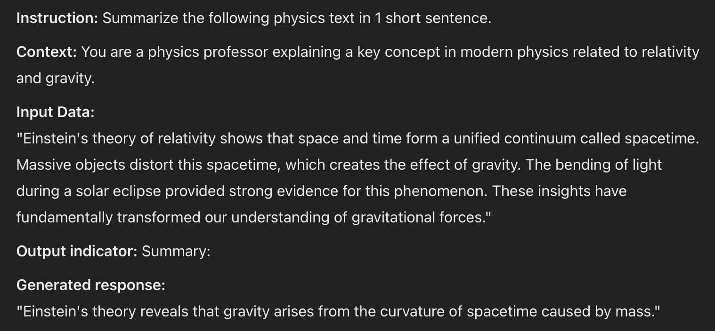
Designing Prompts for Different Tasks
Text Summarization
CHATGPT o3-mini-high

Slide 16
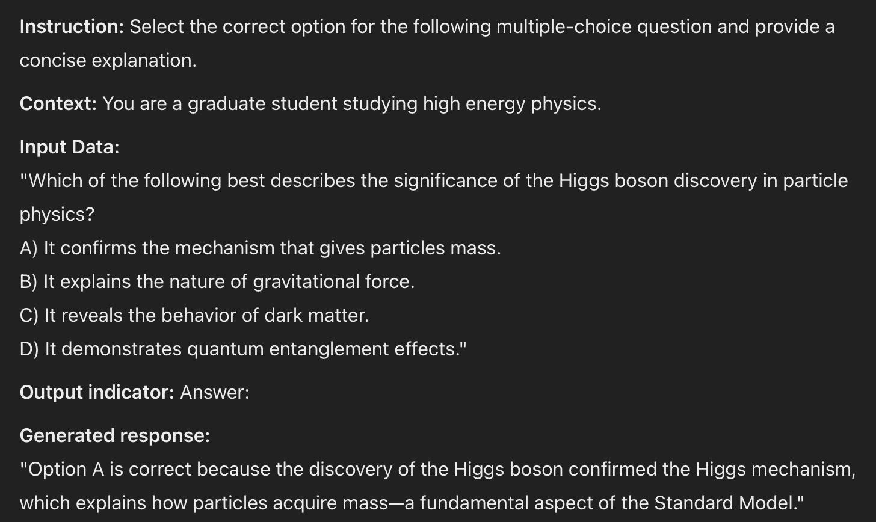
Designing Prompts for Different Tasks
Question Answering
CHATGPT o3-mini-high

Slide 17
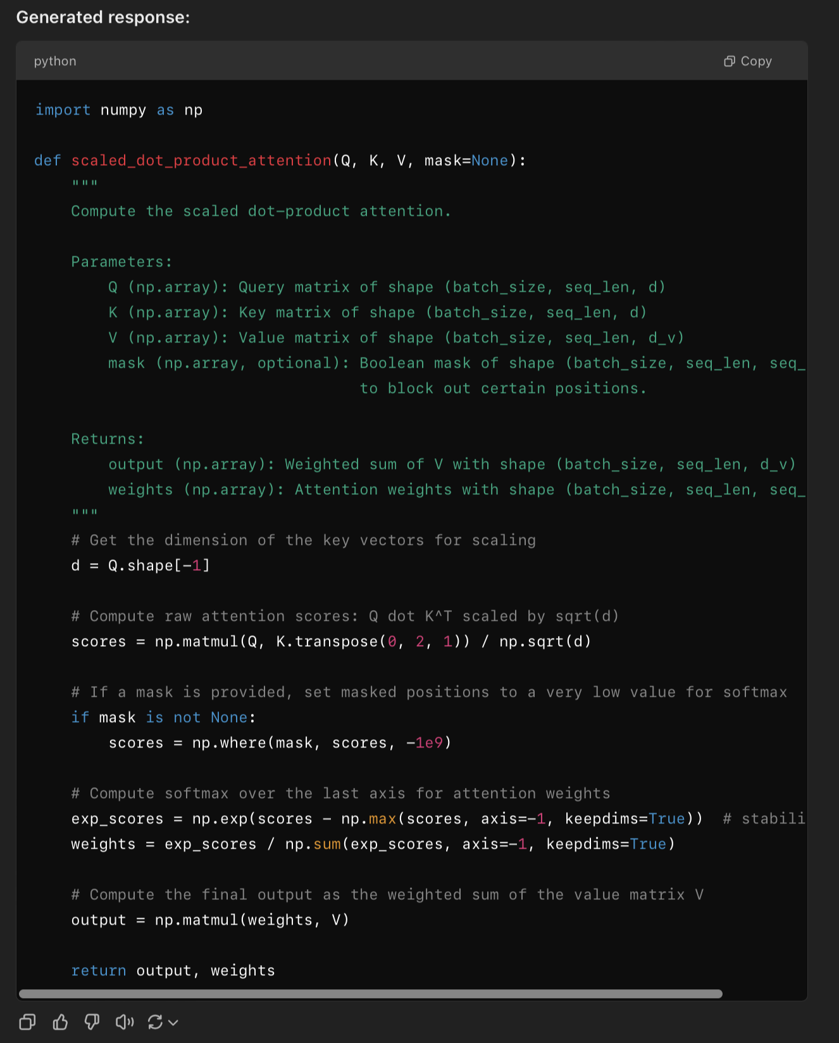
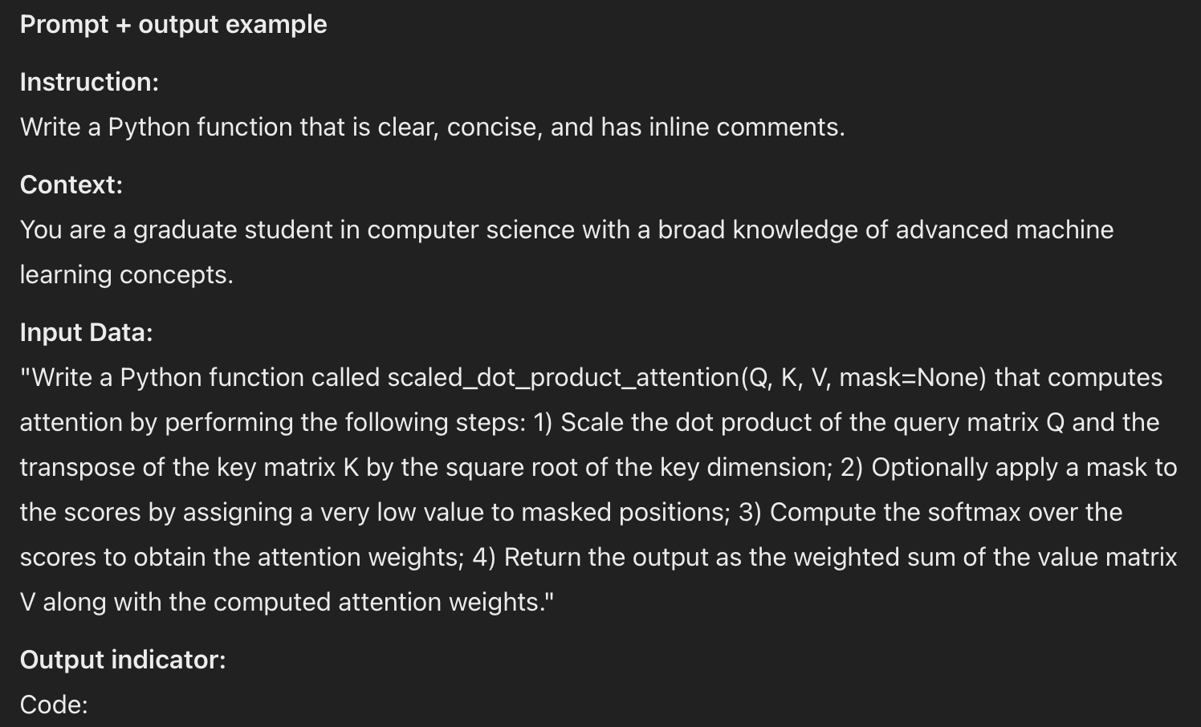
Designing Prompts for Different Tasks
Code Generation
CHATGPT o3-mini-high

Slide 18
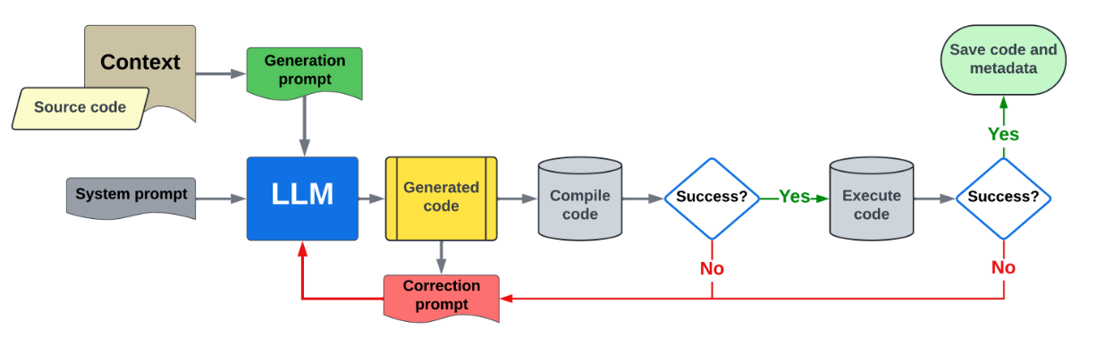
Code Translation In the HPC Context: with LLMs
LASSI: Context + Prompts + Feedback + Iterate
System prompt: “You are a professional coding AI assistant that specializes in translating parallelize codes…”
Static information: Curated content from CUDA and OpenMP C++ reference guides for corresponding translation task, Original source code
Self prompting : LLM generates a summary of the provided programming language domain context. LLM generates a description of the source code functionality
Code generation instruction: “Think carefully before developing the following code that you describe as [insert LLM-generated code description]. Now, generate new code to refactor the following parallelized C++ program written with OpenMP (or CUDA program) to instead use the CUDA framework (or C++ code written with OpenMP directives)…”
Code correction instruction: “[insert generated code] – The above code was compiled with [insert compile command] and produced the following compile/execution error: [insert error]. Re-factor the above code with a fix to eliminate the stated error.”
M. T. Dearing, Y. Tao, X. Wu, Z. Lan and V. Taylor, "LASSI: An LLM-Based Automated Self-Correcting Pipeline for Translating Parallel Scientific Codes," in 2024 IEEE International Conference on Cluster Computing Workshops (CLUSTER Workshops), Kobe, Japan, 2024,

Slide 19
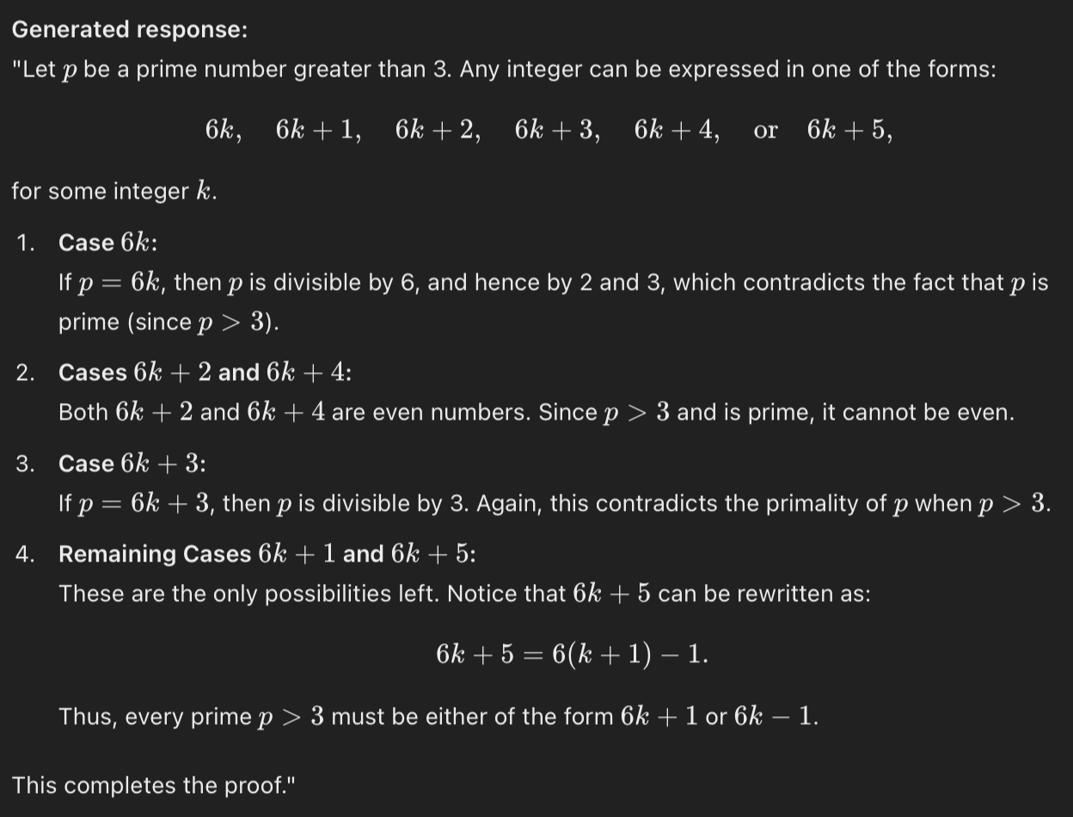
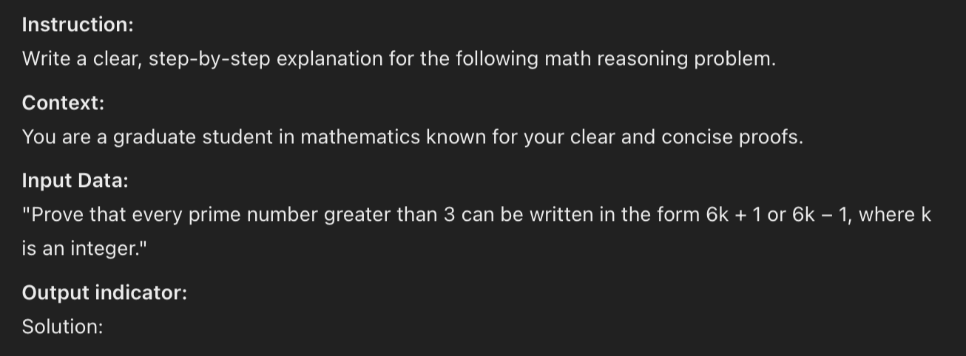
Designing Prompts for Different Tasks
Reasoning
CHATGPT o3-mini-high

Slide 20
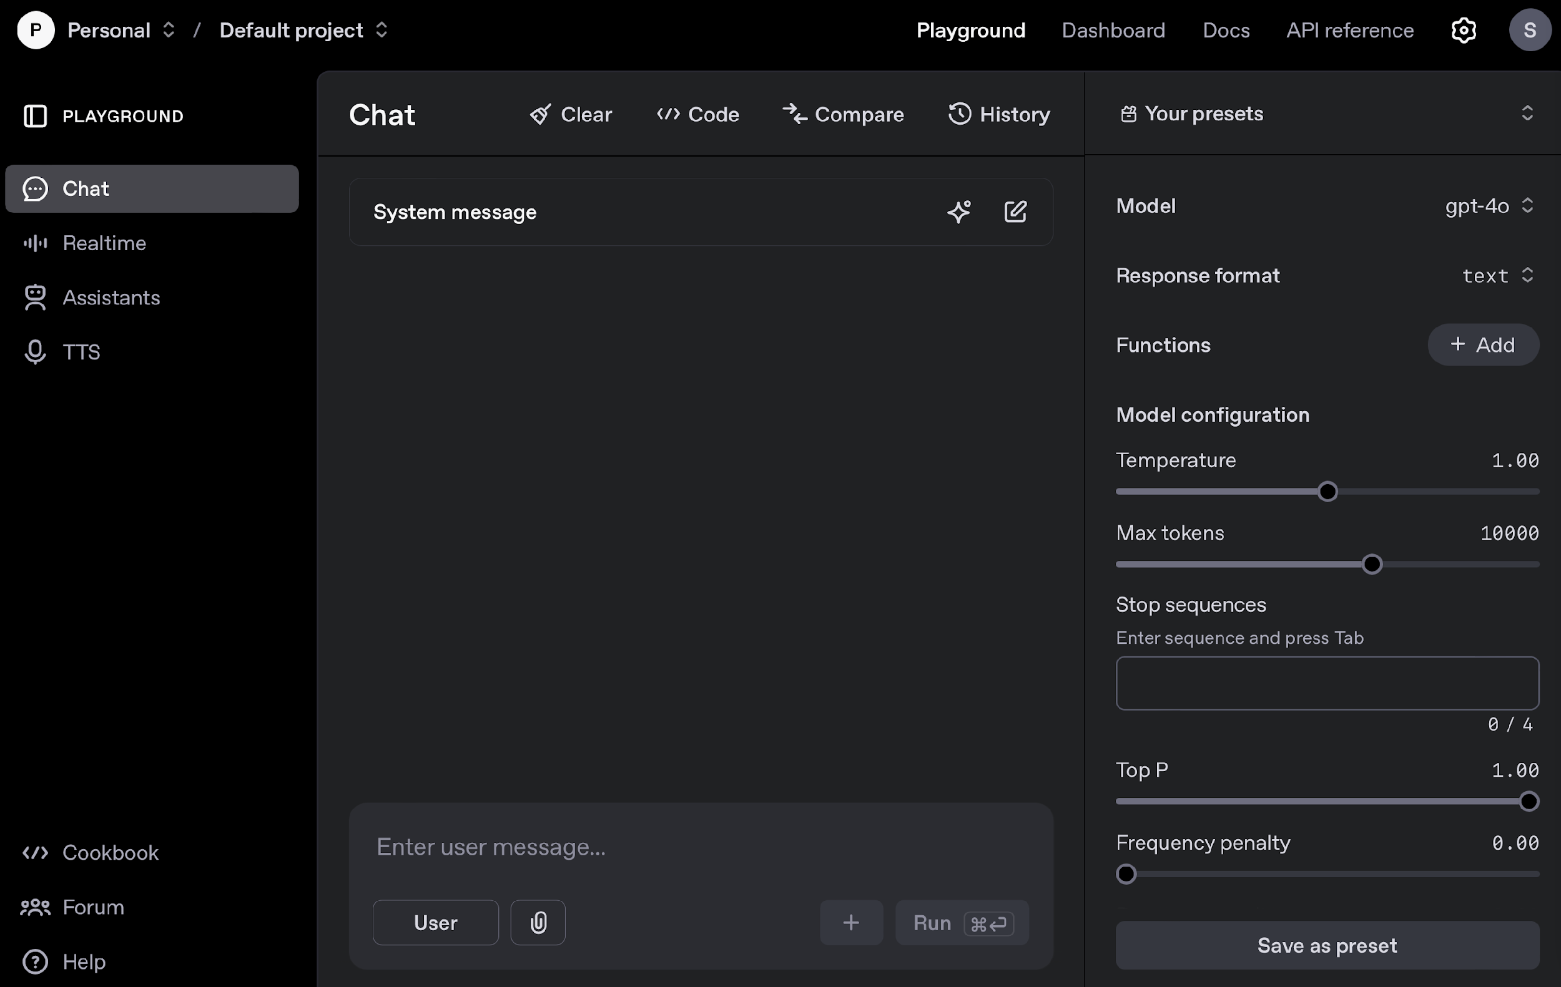
Prompt Engineering Techniques
“LLMs are shown to be sensitive to the prompt format; in particular, semantically similar prompts may have drastically different performance, and the optimal prompt formats can be model-specific and task-specific.”
Notes:
When prompting a language model, you should keep in
mind a few settings
• You can get very different results with prompts when using
different settings
• One important setting is controlling how deterministic the
model is when generating completion for prompts
• Temperature and top_p are two important parameters to keep
in mind
keep these low if you are looking for exact answers
keep them high if you are looking for more diverse responses
top_p computes the cumulative probability distribution, and cut off as soon as that distribution exceeds the value of top_p. For example, a top_p of 0.3 means that only the tokens comprising the top 30% probability mass are considered.
Instead of sampling only from the most likely K words, in Top-p sampling chooses from the smallest possible set of words whose cumulative probability exceeds the probability p . The probability mass is then redistributed among this set of words. This way, the size of the set of words ( a.k.a the number of words in the set) can dynamically increase and decrease according to the next word’s probability distribution.

Slide 21
Advanced Prompting Techniques
Designed to improve performance on complex tasks
  Few-shot prompts
  Chain-of-thought (CoT) prompting
  Self-Consistency
  Knowledge Generation Prompting
  ReAct
  Automatic prompt optimization

Slide 22
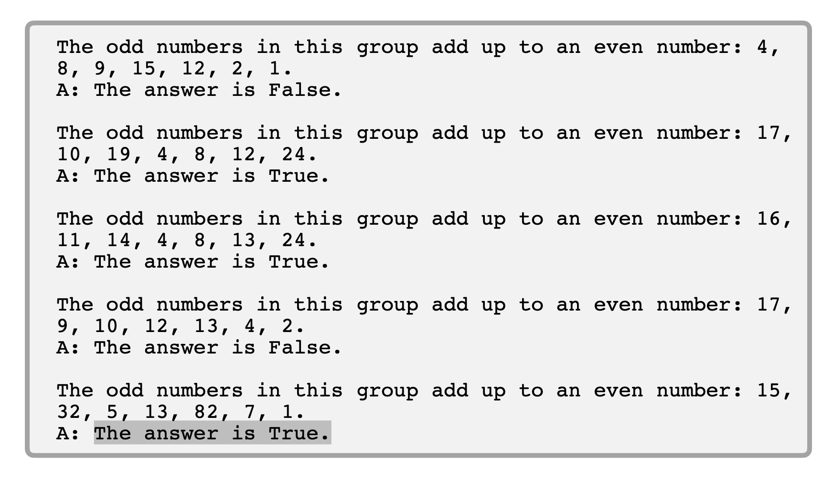
Few Shot Prompts / In-context learning
Allows us to provide exemplars in prompts to steer the model towards better performance

Slide 23
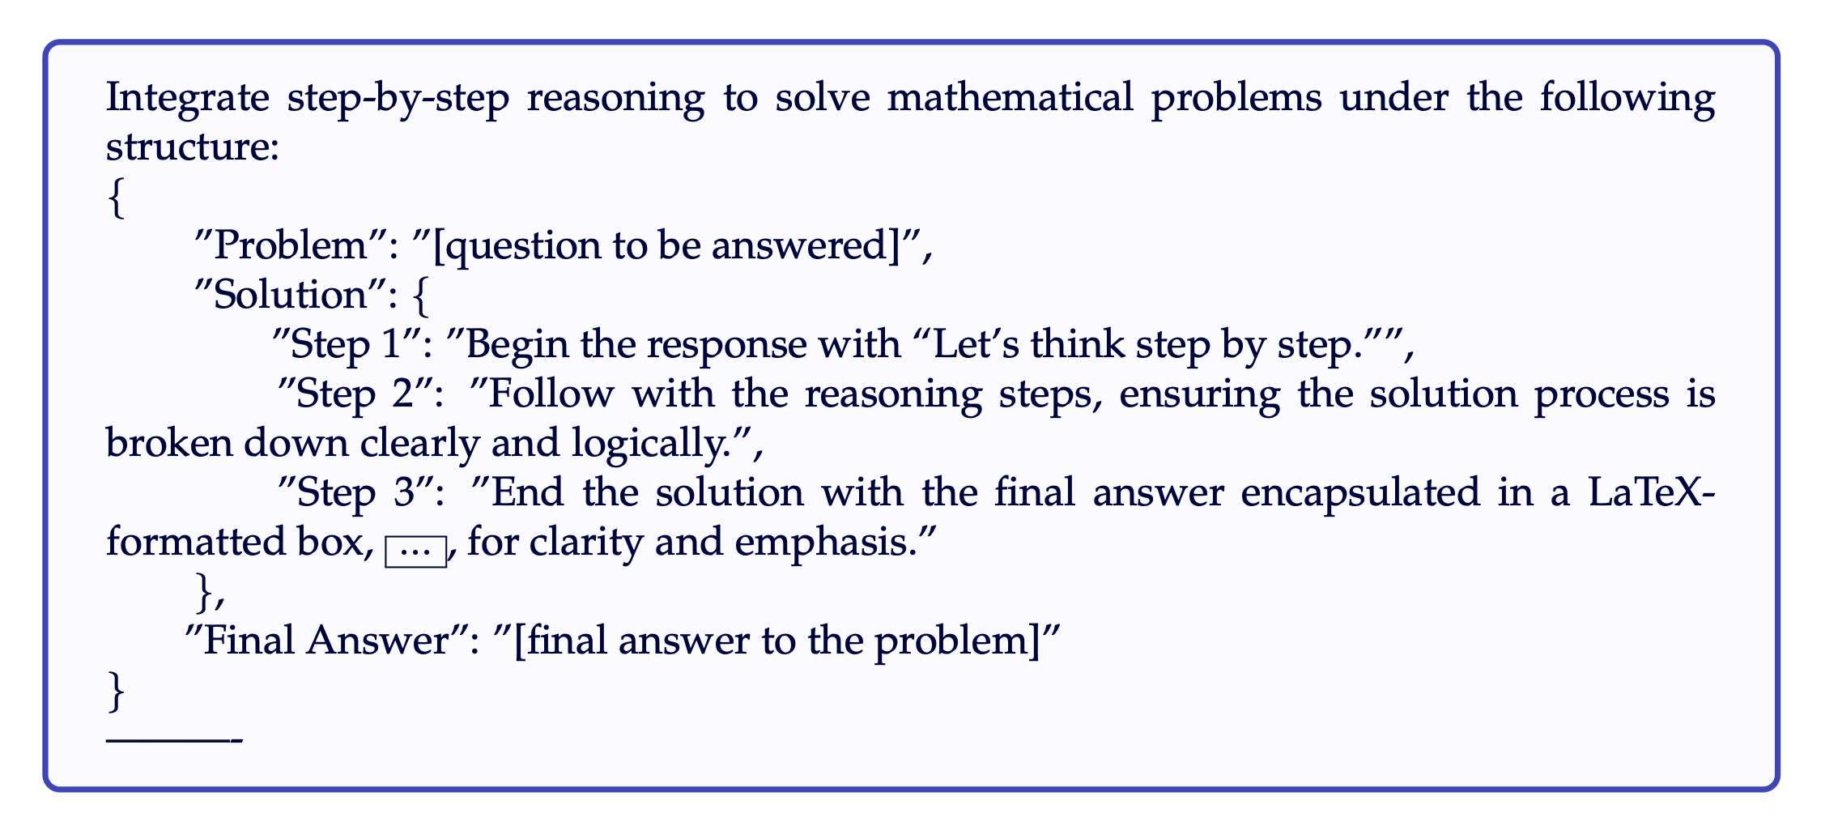
Meta Prompting
Prompt that abstract procedural frameworks and syntactic patterns, rather than specific content details
Differs from Few-Shot Prompting in both its methodology and objectives.
  Few-shot prompting limited set of example problems and solutions to facilitate learning from these instances.
  Meta Prompting prompts that guide the model through logical steps without relying on specific content-based examples.

Slide 24
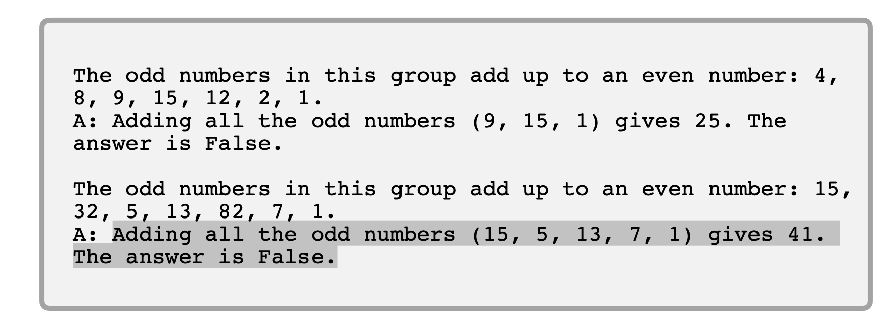
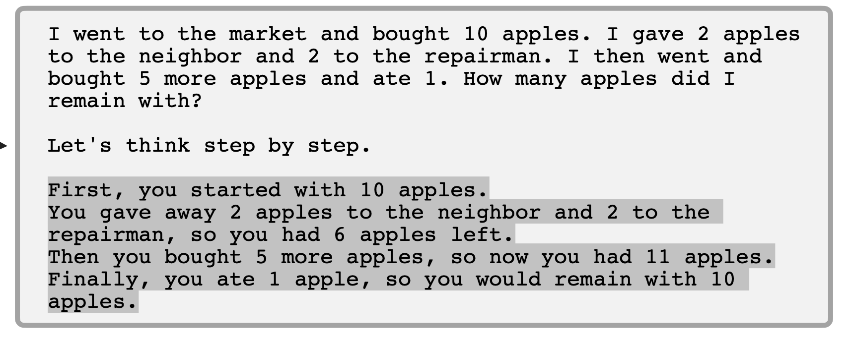
Chain-of-Thought (CoT) Prompting
Prompting can be further improved by instructing the model to reason about the task when responding
  This is very useful for tasks that requiring reasoning
  You can combine it with few-shot prompting to get better results
  You can also do zero-shot CoT where exemplars are not available

Slide 25
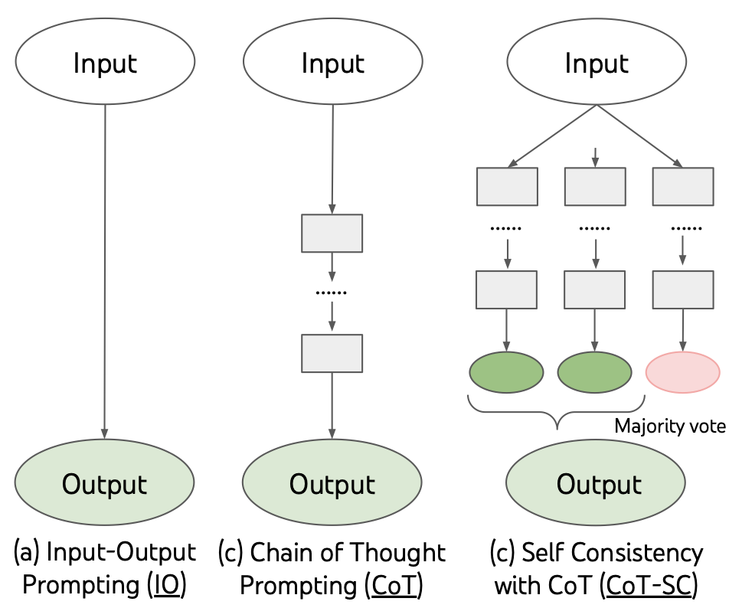
Self-Consistency
Self-Consistency aims to improve on the naive greedy decoding used in chain-of-thought prompting
The idea is to sample multiple, diverse reasoning paths through few-shot CoT, and use the generations to select the most consistent answer.
This helps to boost the performance of CoT prompting on tasks involving arithmetic and commonsense reasoning

Slide 26
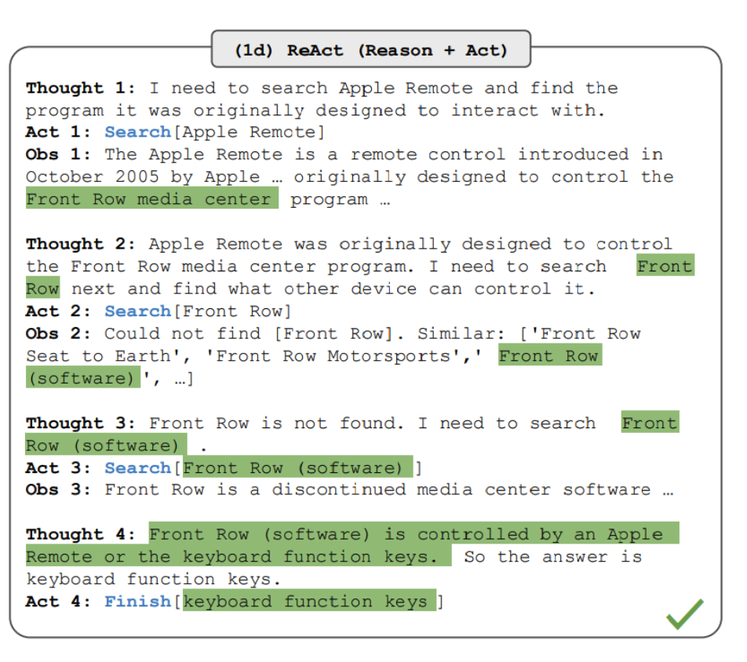
ReAct
ReAct is a framework where LLMs are used to generate both reasoning traces and task-specific actions in an interleaved manner
  Generating reasoning traces allow the model to induce, track, and update action plans, and even handle exceptions
  The action step allows to interface with and gather information from external sources such as knowledge bases or environments.
ReAct allows LLMs to interact with external tools to retrieve additional information that leads to more reliable and factual responses

Slide 27
Automated Prompt Optimization
The process of systematically refining prompts to enhance the performance of Large Language Models (LLMs) across various tasks.​
Reduce Manual Trial and Error: Automating prompt optimization minimizes the labor-intensive process of manually tweaking prompts.
Enhance Consistency: Systematic, data-driven approaches help achieve more reliable and stable outputs from LLMs.
Uncover golden Prompts: Automated methods can discover prompt formulations that outperform those crafted by human experts.
Lower Entry Barriers: Non-experts can benefit from optimized prompts without needing deep domain expertise in prompt engineering.
Scale to Complex Tasks: Efficient, automated optimization enables handling of large-scale and multifaceted tasks that manual tuning cannot easily address.

Slide 28
Automated Prompt Optimization
Continuous (Soft) Prompt Optimization
  Prefixtuning, Prompttuning
Discrete Prompt Optimization
  AutoPrompt, RLPrompt, TEMPERA
Optimization via Natural Language Guidance
  APE, APO, GriPS, OPRO
Evolutionary Algorithm-based Prompt Optimization Techniques
  GPS, EvoPrompt, PromptBreeder
Advanced Differentiation Framework (LLM-AutoDiff) workflows

Slide 29
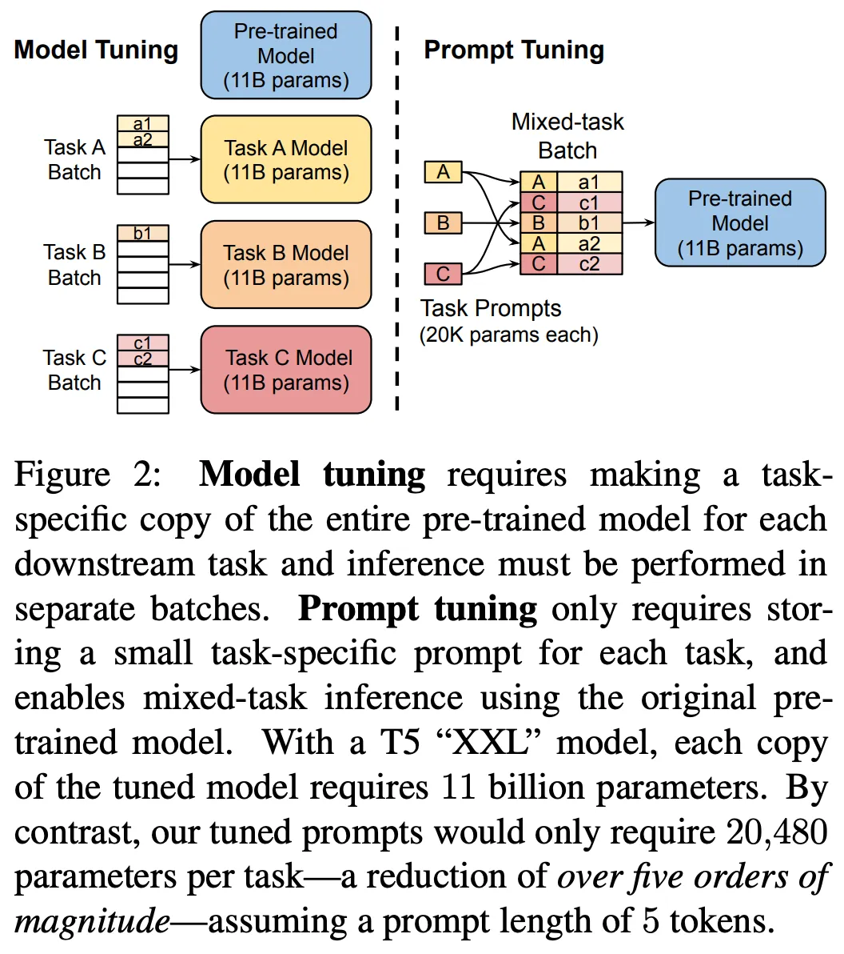
Prompt Tuning
Learns a continuous “soft” prompt while keeping the main model weights fixed.
Prepends a trainable sequence of vectors to the input to steer the model’s output.
Optimized using standard gradient descent over a small number of parameters.
Offers parameter efficiency, reducing memory and computational requirements.
The resulting soft prompt improves task performance despite being non-interpretable.
Notes:
learns a tiny vector of task-specific embeddings (“soft prompts”) that prepends to the frozen parameters of a large language model (LLM). Instead of editing the model’s billions of weights, we adjust only a few hundred or thousand prompt parameters via back-propagation, achieving competitive accuracy with <0.1 % of the trainable weights and dramatically lower compute/storage cost﻿

Slide 30
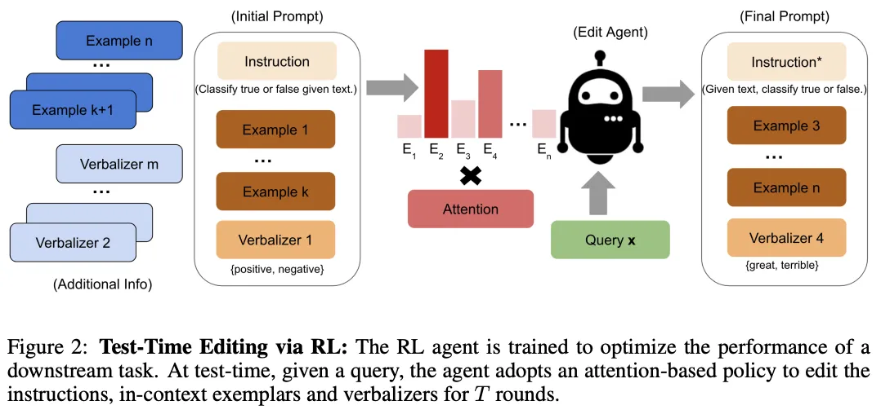
TEMPERA
Uses RL to adapt the prompt at test time based on input-specific feedback.
Dynamically edits the base prompt by modifying instructions, few-shot examples, or verbalizers.
Operates within a discrete action space defined by predetermined edit operations.
Rewards are based on measurable performance improvements after each prompt edit.
Designed for data efficiency and adaptability across diverse tasks.

Slide 31
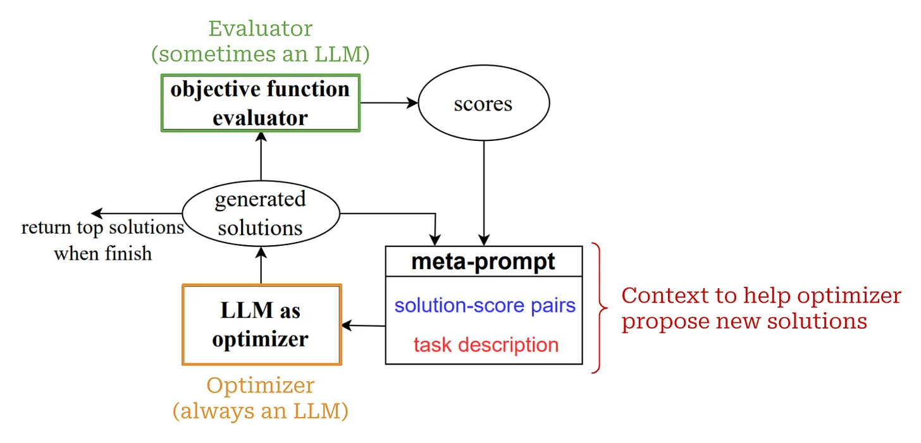
Optimization by PROmpting (OPRO)
Frames prompt optimization as a natural language optimization problem using meta-prompts.
An optimizer LLM generates candidate prompts guided by a meta-prompt containing prior solutions.
An evaluator (LLM or algorithm) scores candidates based on an objective function.
Iteratively refines the prompt by incorporating the best-performing candidates.
Achieves high performance with minimal training data by surpassing human-crafted prompts.

Slide 32
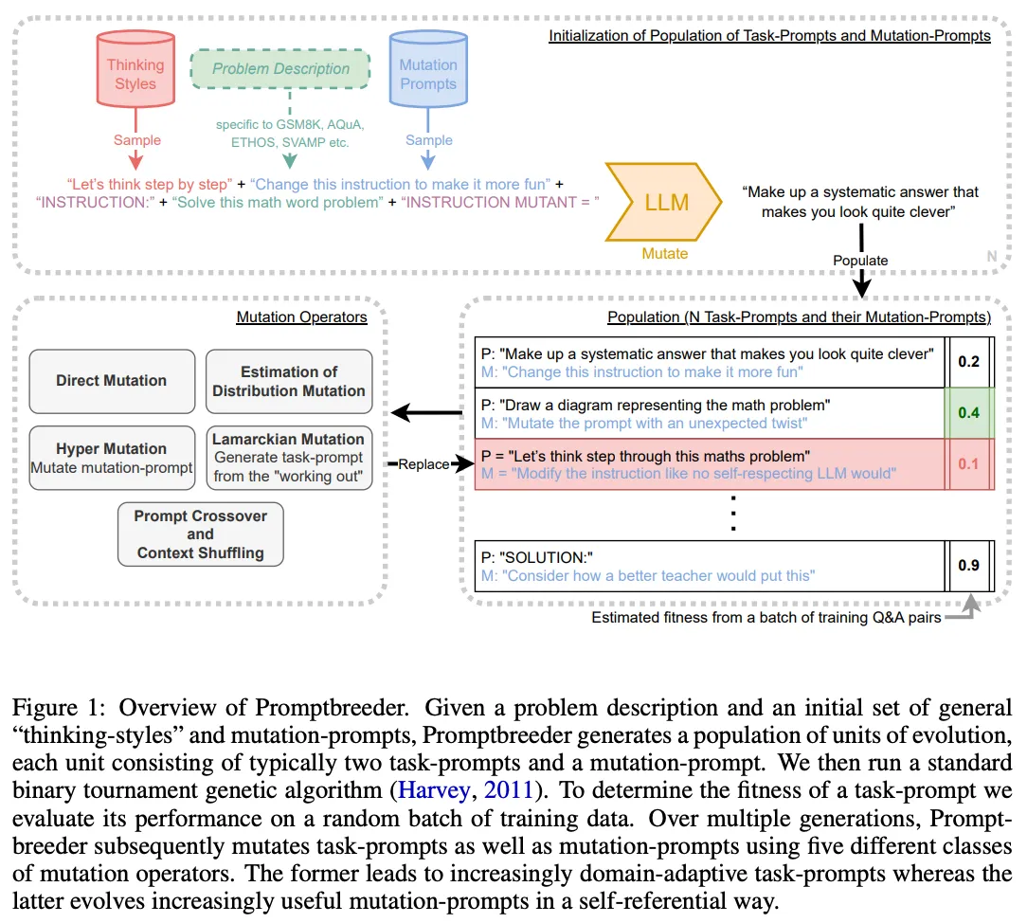
PromptBreeder
Employs evolutionary algorithms to optimize both the task prompt and the mutation prompts used for editing.
Begins with a human-written prompt population and applies genetic operators like mutation and crossover.
Evaluates prompt variants on a validation set, selecting top performers for further evolution.
Introduces a self-improvement mechanism by also optimizing the instructions that generate new mutations.
Demonstrates strong performance on reasoning benchmarks compared to conventional methods.

Slide 33
LLM-AutoDiff
Leverages automatic differentiation techniques to enable gradient-based optimization for prompts.
Treats the prompt as a differentiable input, allowing gradient updates on discrete tokens.
Approximates gradients to bridge the gap between continuous and discrete optimization.
Can be integrated with API-based LLMs using surrogate gradient estimators.
Aims to combine the interpretability of discrete prompts with the efficiency of gradient-driven methods.

Slide 34
Questions?

Slide 35
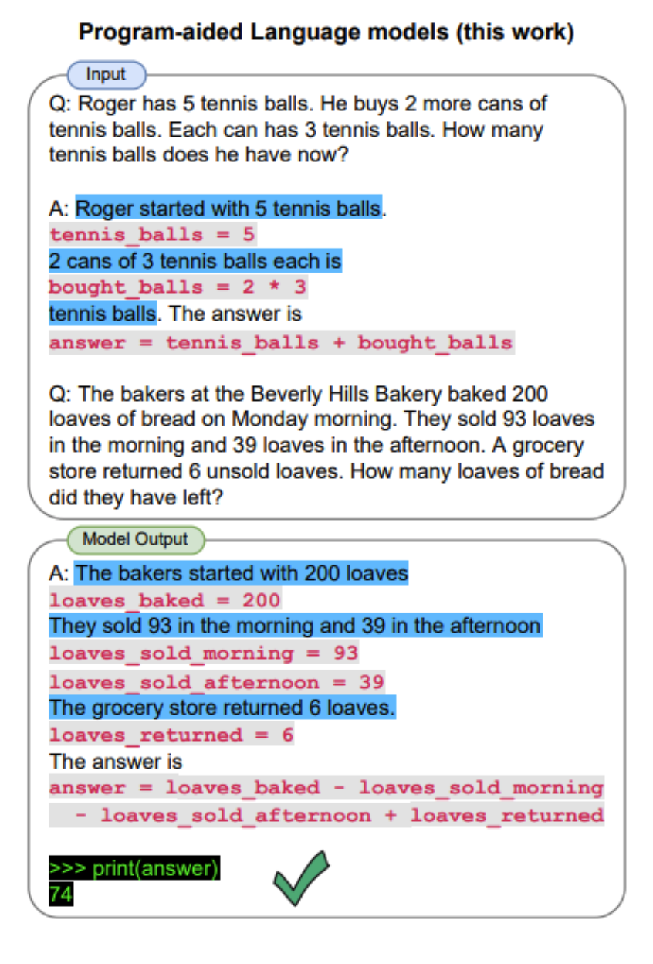
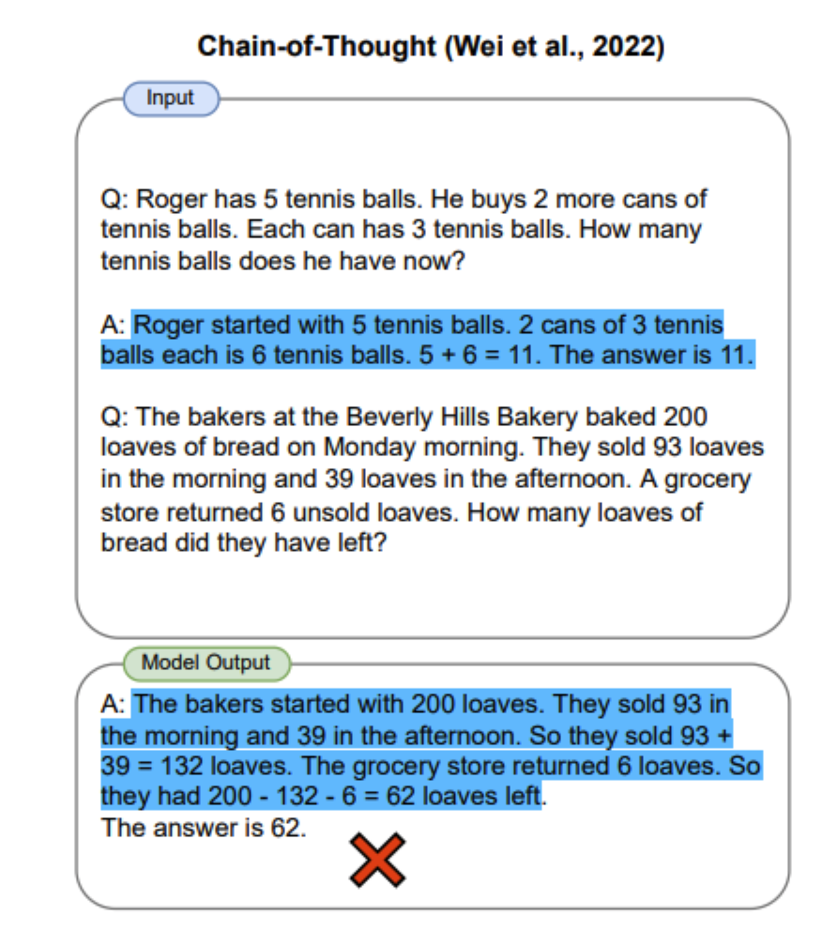
Program-aided Language Model (PAL)
Chain-of-thought prompting is a good example of how to steer models to perform better at complex reasoning tasks
  However, sometimes CoT is not enough as it depends only on the generated text from the model
Program-aided language models (PAL) uses an LLM to read problems and generate programs as the intermediate reasoning steps
  It offloads the solution step to a runtime such as Python interpreter

Slide 36
Settings to keep in mind – OpenAI playground
When prompting a language model, you should keep in
mind a few settings
• You can get very different results with prompts when using
different settings
• One important setting is controlling how deterministic the
model is when generating completion for prompts
• Temperature and top_p are two important parameters to keep
in mind
  keep these low if you are looking for exact answers
  keep them high if you are looking for more diverse responses

Slide 37
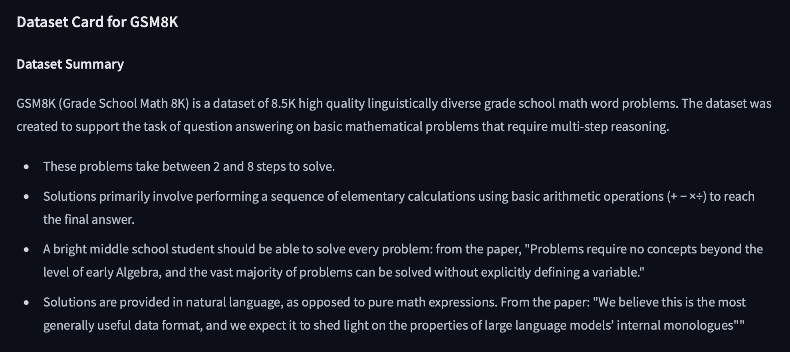
GSM8K (Graduate School Math)

Slide 38
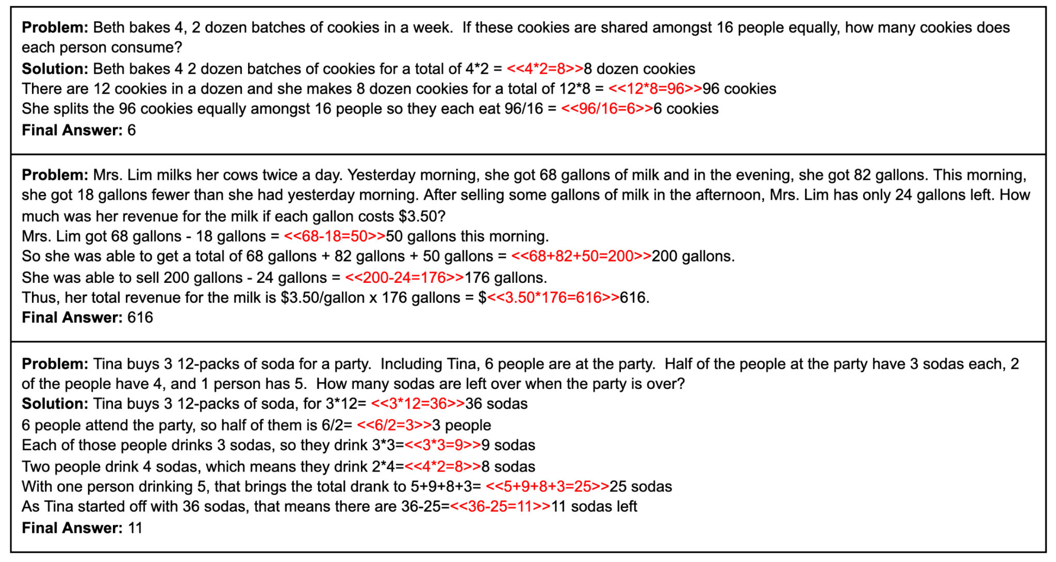
GSM8K (Graduate School Math)

Slide 39
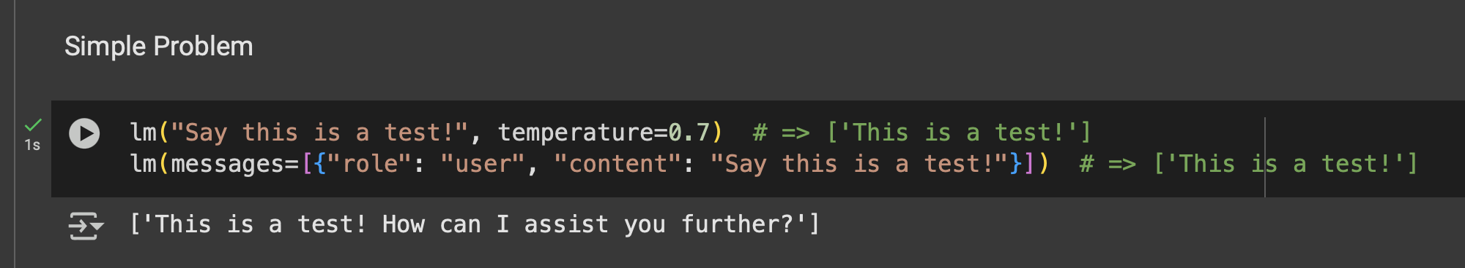
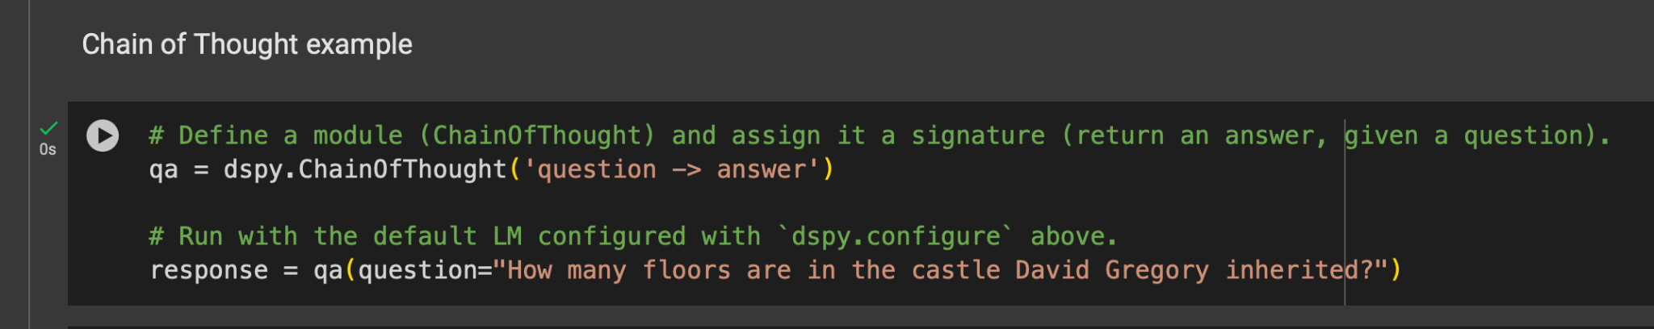
DSpy
https://colab.research.google.com/drive/1rxZW0V4cqT6dip5HAXhk3QxjnbDro0oM?usp=sharing
The question refers to a specific detail about a fictional or historical castle associated with David Gregory. However, without additional context or information about which David Gregory or which castle is being referenced, it is impossible to provide an accurate answer. The number of floors in a castle can vary widely depending on its design, size, and historical context.
The number of floors in the castle David Gregory inherited is not specified in the information available.

Slide 40
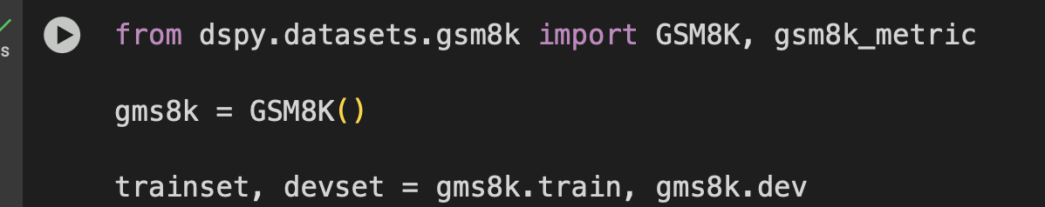
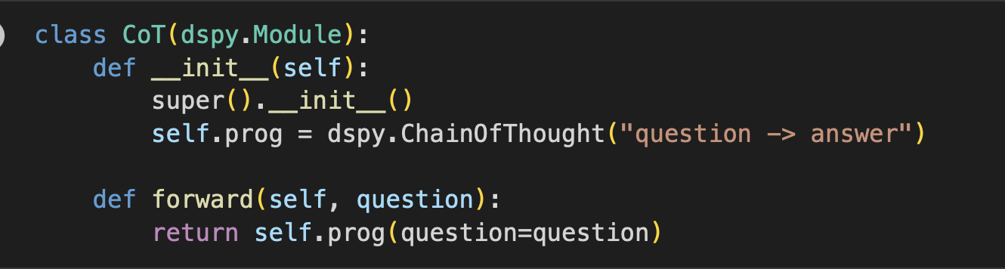
Prompt Optimization for GSM8K
https://colab.research.google.com/drive/1rxZW0V4cqT6dip5HAXhk3QxjnbDro0oM?usp=sharing

Slide 41
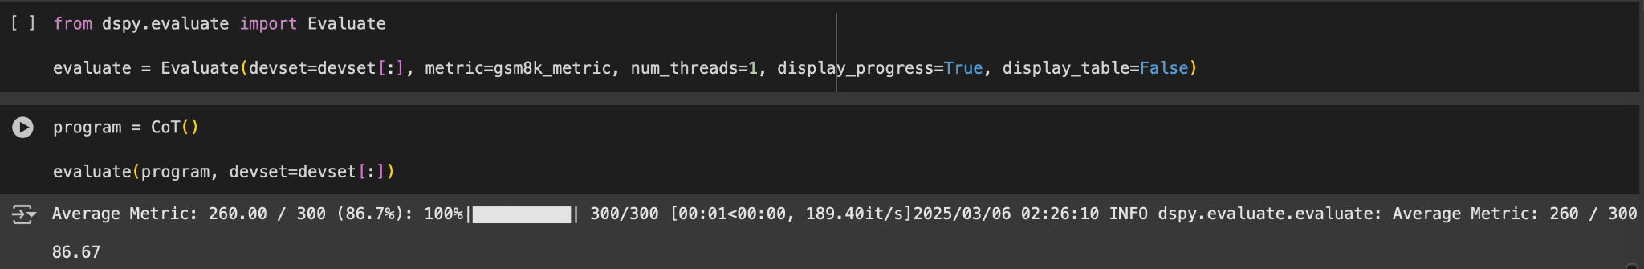
Prompt Optimization for GSM8K
https://colab.research.google.com/drive/1rxZW0V4cqT6dip5HAXhk3QxjnbDro0oM?usp=sharing

Slide 42
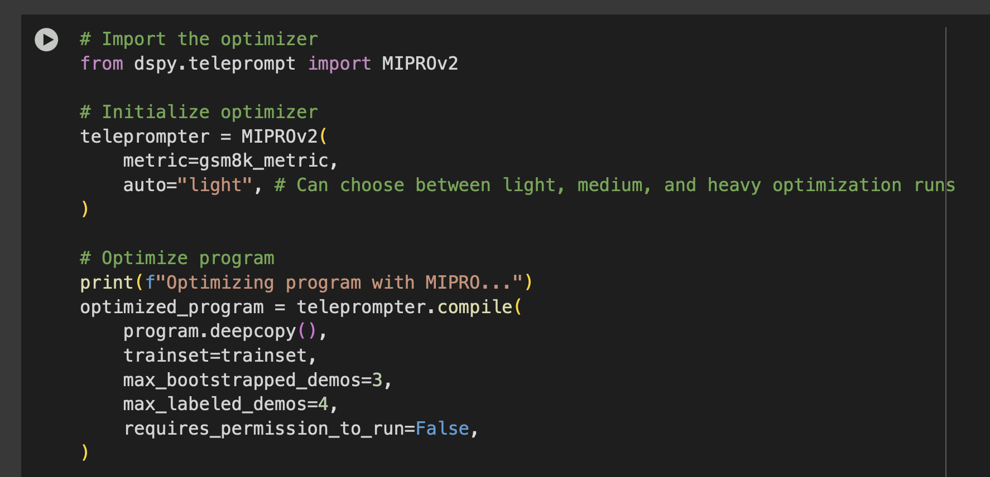
Prompt Optimization for GSM8K
https://colab.research.google.com/drive/1rxZW0V4cqT6dip5HAXhk3QxjnbDro0oM?usp=sharing

Slide 43
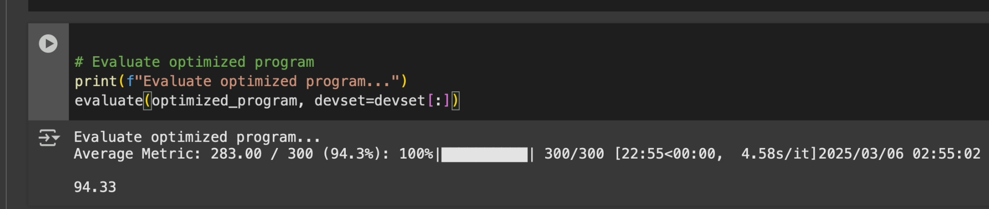
Prompt Optimization for GSM8K
https://colab.research.google.com/drive/1rxZW0V4cqT6dip5HAXhk3QxjnbDro0oM?usp=sharing

