Slide 1
Directions, Recommendation, and Collection Tool Overview
Franck Cappello (Argonne) &
Neil Getty (Argonne)

Slide 2
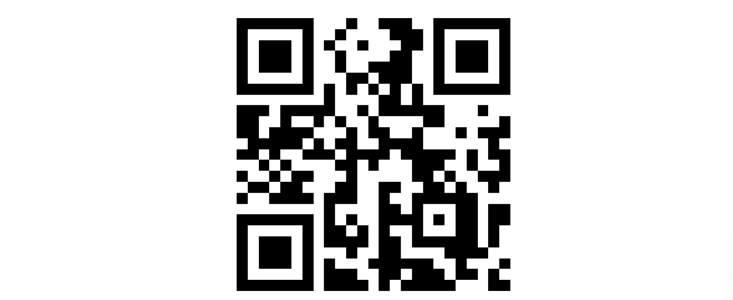
Collection tool
https://tinyurl.com/mr3z93jz
https://web.cels.anl.gov/projects/auroragptquestions/ui/labstyle
Password: anllabstyle

Slide 3

Model Access
Use whatever commercial or local models you have access to institutionally/individually and are comfortable with
Free trial for .edu addresses: https://gemini.google/students/

Slide 4
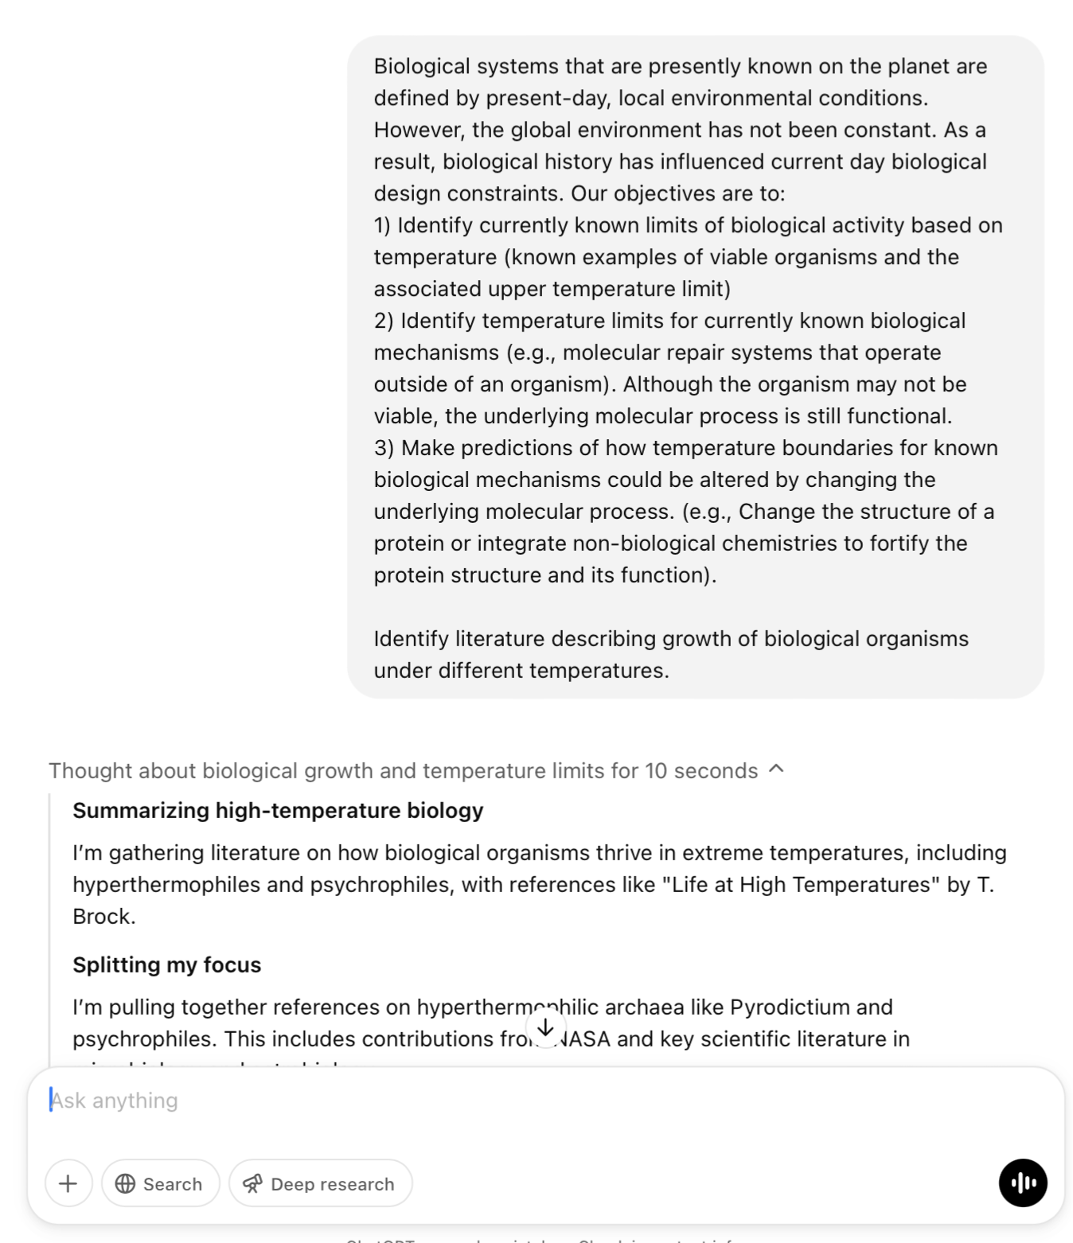
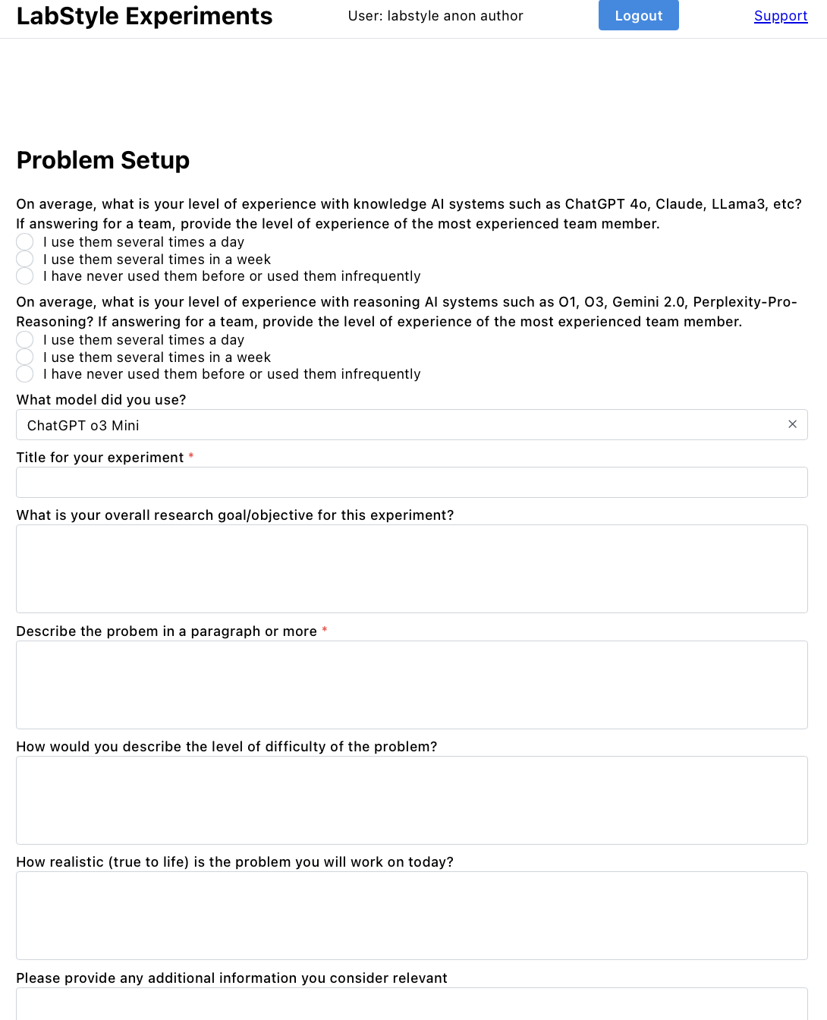
1 Window for the model, 1 Window for the Collection
Model
Collection

Slide 5
1 Problem 1 Collection
Problem
Collection

Slide 6
Same problem/ 2 (or more) AI Models → 2 (or more) Collections
…
Model 2
Collection 2
Model 1
Collection 1

Slide 7
What to do when stuck?
If the problem is hard enough, at some point, you will not be able to progress anymore.
Different options:
1) Discuss within the group to identify a path forward
2) You know that there is a path forward → orient the model in this direction (a clarification prompt, clarify/reformulate the whole problem, simplify the problem, etc.)
3) To progress, you will need the expertise of another researcher (possibly in another domain)
4) Switch to another problem

Slide 8
No PII (Keep your interactions with the model anonymous.)
PII is an individual's first name (or first initial) and last name with any of the following information:
Social Security number
Passport or visa number
Driver's license number or state identification card number
Credit card or bank account numbers or associated security codes or passwords
Credit reports or similar financial records
Full birth date or place of birth
Mother's maiden name
Criminal records of arrests, convictions or incarcerations
Medical records with information such as disease diagnoses or vital statistics
Official educational transcripts showing courses and grades
Biometric data such as fingerprints or retinal scans
Collections of security clearance information, such as a list of employees showing their clearance levels

Slide 9
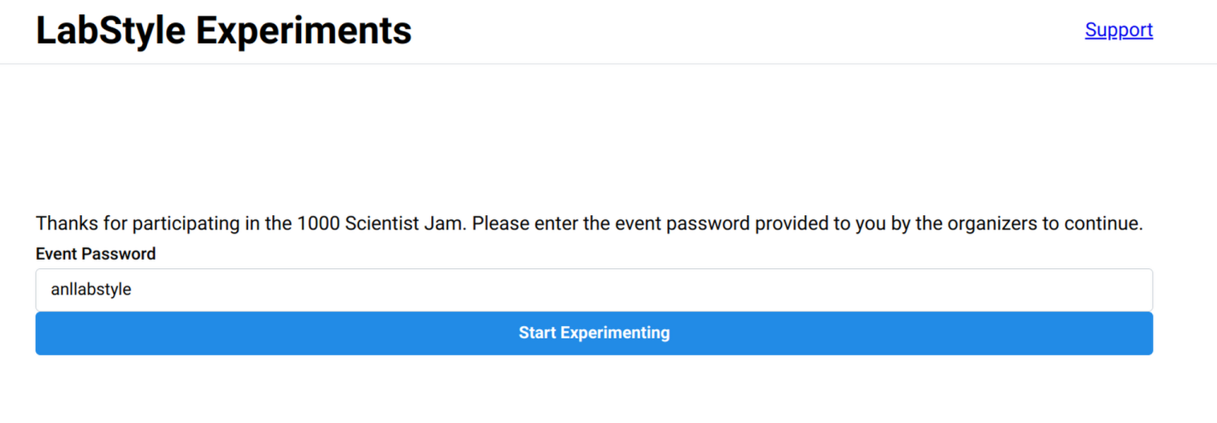
Tool: Logging In: Password “anllabstyle”

Slide 10
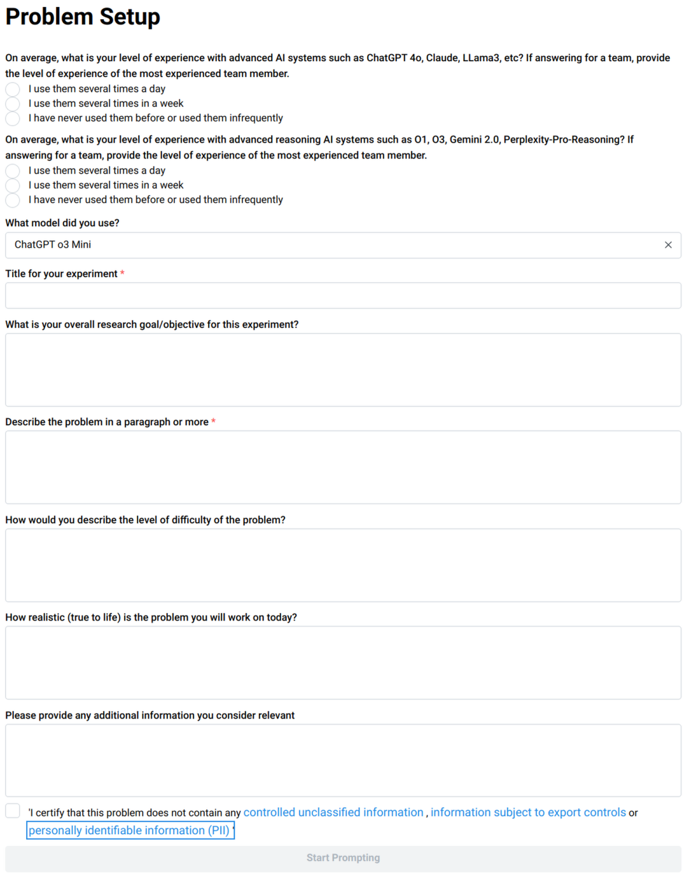
Tool: Problem Setup
You can list other models
Title and Description are Required, but please be as complete as possible
You must acknowledge that to the best of your knowledge, the problem you are studying does not contain PII, Export Controls, or Controlled Unclassified Information
This will be reviewed by the lab to confirm

Slide 11
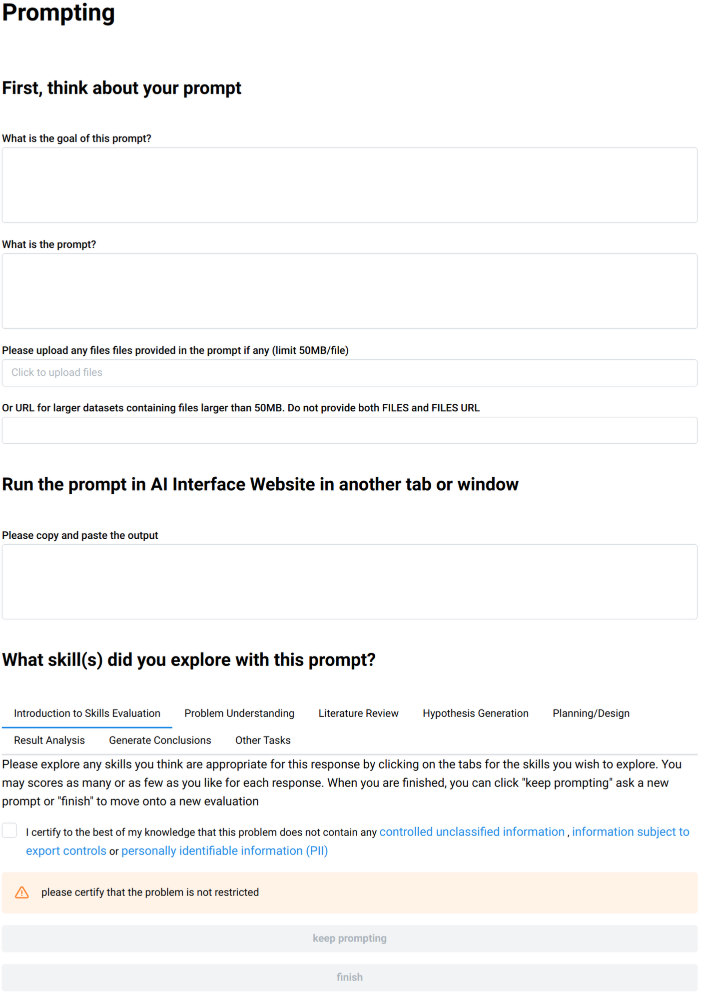
Tool: Prompting
Prepromting
Files limited to 50MB/file OR URL
Output
Assessment/Exploration
All optional, do what makes sense for the prompt
Don’t forget to ensure no CUI/PII in submission
Keep Prompting OR Finish

Slide 12
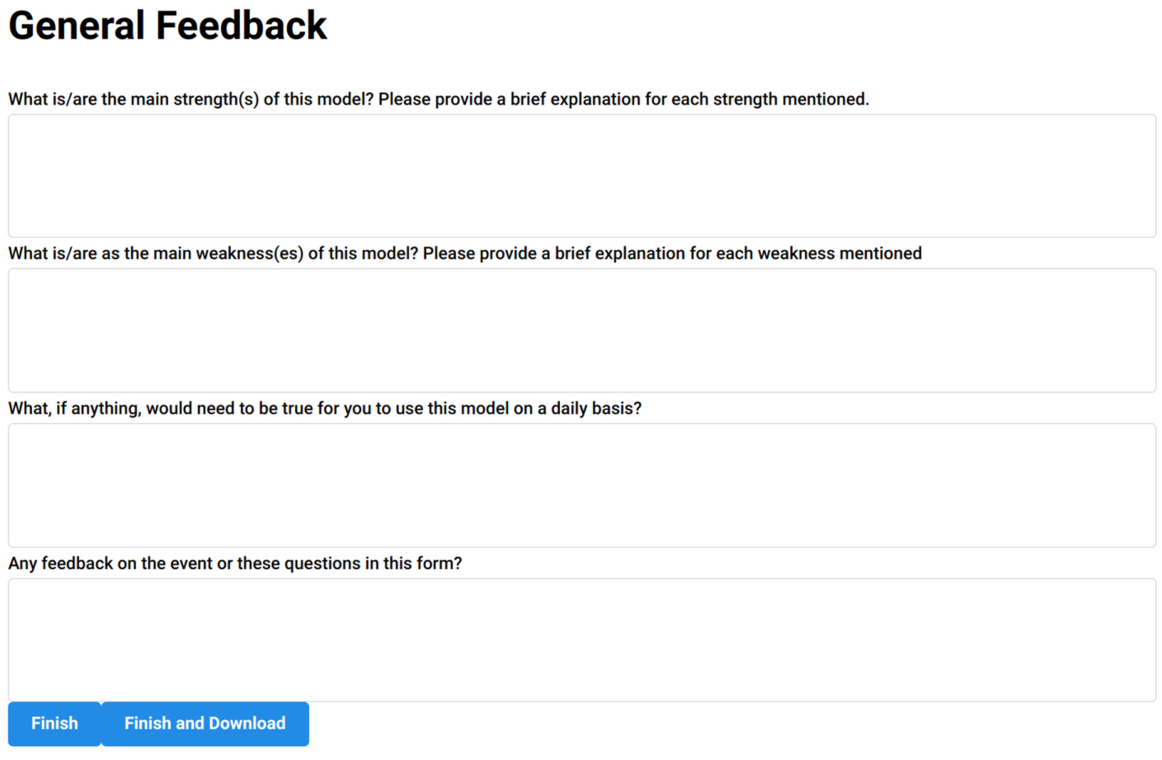
Tool: Final Assessment
Some quick general/feedback or impressions
Finish: Done this this Experiment
Finish and Download also saves a copy of your answers from your browser to your computer

Slide 13
Problem Understanding
Level 1: Unsatisfactory Performance
Demonstrates minimal understanding of the research problem. Misinterprets key concepts and objectives. Fails to recognize the significance or relevance within the field. May confuse or conflate unrelated ideas.
Level 2: Basic Performance Level
Shows a basic grasp of the main aspects of the problem. Identifies primary issues but overlooks complexities and subtleties. Provides general explanations but may oversimplify critical elements. Requires guidance to comprehend deeper implications.
Level 3: Intermediate Performance Level
Exhibits thorough understanding of the problem, including underlying mechanisms and contributing factors. Articulates the significance and context within the field. Recognizes complexities and explores interrelationships between concepts. Begins to consider potential challenges.
Level 4: Elevated Performance Level
Demonstrates comprehensive and nuanced understanding. Clearly articulates complexities, interdependencies, and broader impacts. Identifies gaps in existing knowledge and potential areas for advancement. Employs critical thinking to question assumptions and explore alternative perspectives.
Level 5: Exceptional Performance Level
Showcases exceptional insight into the problem. Connects it to a broad spectrum of theories and practices. Anticipates future challenges and opportunities. Contributes original thoughts that shape understanding within the field. Influences how the problem is perceived and addressed.

Slide 14
Literature Review
Level 1: Unsatisfactory Performance
Presents minimal or irrelevant literature. Sources are outdated, non-rigorous, or inappropriate. Fails to include key studies or influential authors. Does not demonstrate understanding of the existing research landscape.
Level 2: Basic Performance Level
Includes a basic selection of literature using general sources. References some relevant works but misses significant studies. Shows limited ability to assess source credibility. Relies heavily on textbooks or secondary summaries instead of primary research articles.
Level 3: Intermediate Performance Level
Provides a well-rounded review, referencing key studies and prominent authors. Utilizes appropriate collections to source relevant and credible rigorous articles. Critically assesses and synthesizes information from multiple sources. Identifies main themes and gaps in the literature.
Level 4: Elevated Performance Level
Delivers a comprehensive literature review, including foundational works and the latest research. Synthesizes information to identify inconsistencies and debates within the field. Integrates interdisciplinary sources where appropriate. Evaluates methodologies and theoretical frameworks critically.
Level 5: Exceptional Performance Level
Exhibits exhaustive knowledge of the literature, including emerging and obscure works. Establishes connections across fields to provide innovative perspectives. The review contributes new insights or proposes novel frameworks. Influences future research directions through synthesis provided.

Slide 15
Hypothesis Generation
Level 1: Unsatisfactory Performance
Does not formulate a clear hypothesis or research question. Ideas are vague, unfocused, or untestable. Shows little connection to the problem or literature. Lacks originality and understanding of research fundamentals.
Level 2: Basic Performance Level
Develops a basic hypothesis or question that addresses the problem superficially. May lack depth or originality. Testable but not well-aligned with theoretical frameworks. Requires refinement to clarify variables and scope.
Level 3: Intermediate Performance Level
Constructs a clear, focused, and testable hypothesis or question grounded in literature. Demonstrates originality and relevance. Defines variables and anticipated relationships. Aligns with established theories and concepts.
Level 4: Elevated Performance Level
Generates sophisticated hypotheses or questions addressing gaps or controversies. Shows creativity and deep theoretical understanding. Considers alternative outcomes and implications. Potential to advance knowledge significantly.
Level 5: Exceptional Performance Level
Formulates innovative, groundbreaking hypotheses or questions challenging existing paradigms. Reflects profound understanding of the field's trajectory. Proposals are influential, setting new research directions and reshaping the discipline.

Slide 16
Methodology Planning/Experiment Design
Level 1: Unsatisfactory Performance
Provides no plan or an incoherent, impractical one. Fails to address methodological considerations. Omits critical components like objectives or procedures. Neglects ethical, practical, or logistical factors.
Level 2: Basic Performance Level
Outlines a basic plan with general procedures. Lacks detail and may overlook important variables or controls. Doesn't fully consider feasibility or ethics. Requires significant improvement to be viable.
Level 3: Intermediate Performance Level
Develops a detailed, logical plan. Includes appropriate methods, procedures, and resources. Identifies variables, controls, and limitations. Demonstrates understanding of ethical considerations and feasibility.
Level 4: levated Performance Level
Crafts a comprehensive, methodologically sound plan integrating advanced techniques. Anticipates challenges and includes contingencies. Ensures rigorous adherence to ethical standards. Potential to yield significant, reliable results.
Level 5: Exceptional Performance Level
Designs an exemplary plan setting new field standards. Incorporates cutting-edge methods and technologies. Optimizes efficiency and effectiveness. May introduce novel methodologies influencing research practices.

Slide 17
Result Analysis
Level 1: Unsatisfactory Performance
Provides minimal or incorrect analysis. Misinterprets findings or fails to identify key patterns. Does not use appropriate methods. Overlooks anomalies or errors.
Level 2: Basic Performance Level
Performs basic analysis using standard methods. Identifies some findings but may miss deeper insights. May make calculation or reasoning errors. Restates results without significant insight.
Level 3: Intermediate Performance Level
Conducts thorough analysis using appropriate tools. Accurately interprets results, relating them to research questions and literature. Acknowledges limitations and considers alternatives. Demonstrates critical thinking.
Level 4: Elevated Performance Level
Performs sophisticated analysis revealing nuanced insights. Utilizes advanced methods and validates findings. Integrates results with theoretical frameworks. Critically evaluates significance and impact.
Level 5: Exceptional Performance Level
Provides profound analysis leading to new understandings or discoveries. Develops or applies innovative techniques. Results significantly influence the field. Analysis informs policy, practice, or sets new research agendas.

Slide 18
Conclusion and Implication Generation
Level 1: Unsatisfactory Performance
Fails to draw meaningful conclusions or provides unsupported ones. Does not address hypotheses or objectives. Writing is unclear and disorganized. Overlooks broader implications.
Level 2: Basic Performance Level
Summarizes findings at a basic level. Conclusions may restate results without deeper insight. Limited discussion of significance or applications. Does not suggest future research directions.
Level 3: Intermediate Performance Level
Draws clear, logical conclusions addressing objectives. Synthesizes findings and discusses significance within the field. Explores potential applications. Suggests areas for future research.
Level 4: Elevated Performance Level
Crafts comprehensive conclusions integrating findings into broader discourse. Explores theoretical, practical implications in depth. Provides insightful recommendations for further study or practice.
Level 5: Exceptional Performance Level
Delivers compelling conclusions redefining understanding of the topic. Articulates transformative impacts on the field. Writing is of publishable quality in prestigious journals. Conclusions influence research agendas and policy decisions.

