Slide 1

Evaluation of AI Model Scientific Skills
Franck Cappello, Neil Getty, Sandeep Madireddy, Robert Underwood,
Argonne National Laboratory
Notes:
Thanks for the introduction
Thanks Georfrey and YangFeng for the invitation to give a keynote and hosting me.

Slide 2
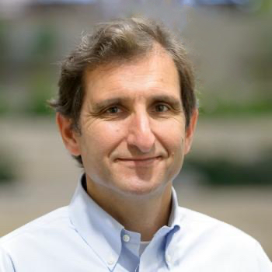
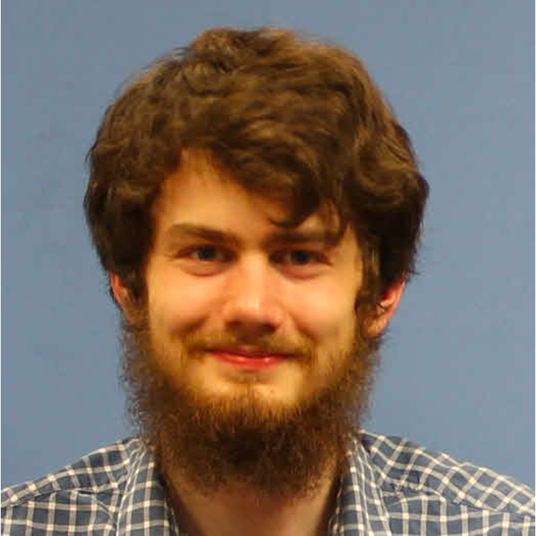
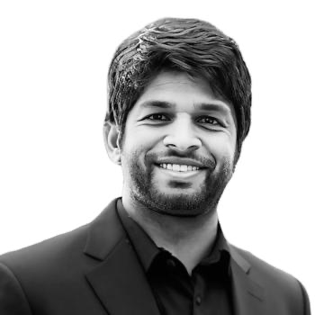
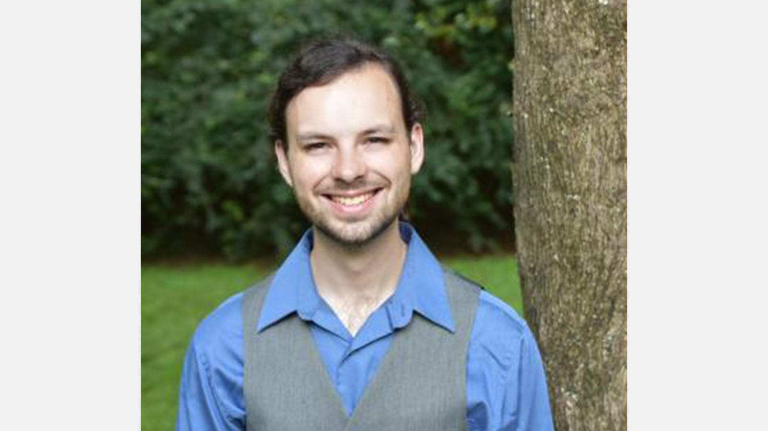
Speakers
Franck
cappello.anl.gov
Neil
ngetty@anl.gov
Sandeep
smadireddy@anl.gov
Robert
Robert
runderwood@anl.gov

Slide 3
Welcome!
What you will learn today
LLM Use Cases in HPC Context
Prompting and Performance
Basics of LLM Evaluation
LLMs as Judges
Intermediate Benchmarking
Uncertainty Quantification
Intermediate Reasoning Evaluation Techniques
Hands-on Exercises

Slide 4
Schedule
Session 1 → Share with all tutorials and hackathons
Session 2 (90 minutes):Basic/Intermediate Evaluation Techniques
11:00-11:10 Introduction of the Tutorial (10 minutes) – [Franck]
11:10-11:35 Use cases of LLMs for HPC (25 minutes) [Franck]
11:35-12:05 Basics of LLMs Evaluation (30 minutes) [Robert]
12:05-12:30 Importance of Prompting on Performance of LLMs for Research (25 minutes) [Sandeep]
Session 3 (90 minutes): Advanced Evaluation Techniques
14:00-14-30 Intermediate Benchmarking of LLMs for Science and Engineering (30 minutes) [Neil]
14:30-15-00 Intermediate Reasoning Evaluation Techniques of LLMs for Science (30 minutes) [Franck]
15:00-15:30 UQ, Hallucination, Safety (30 minutes) [Sandeep]
Seccion 4 (90 minutes): Hands-on: Demo/Field Style Experiment
16:00-16:30 Problem-solving demonstration (30 minutes) [Robert]
16:30-17:30 Field Style Experiment (60 minutes) [Franck, Neil]

Slide 5
Preparing the Field Style Experiment
The goal is to explore a research problem in your domain (preferably open or non-published yet) using LLMs as research assistants.
You will use you favorite models (multiple models can be compared)
Progress over the whole cycle or research from literature search to result analysis
Assess the LLMs responses
We will use an interface where we will collect: prompts, model responses and your assessment of the model responses.
→ Please identify a research problem that you would like to explore before the last session (starts at 16:00).

Slide 6

Link to the slides
https://tinyurl.com/2t857dty

Slide 7

Thanks!
Q&As

