Slide 1
Metadata Guidelines
TWDB Groundwater Modeling Dept
9/26/2022

Slide 2
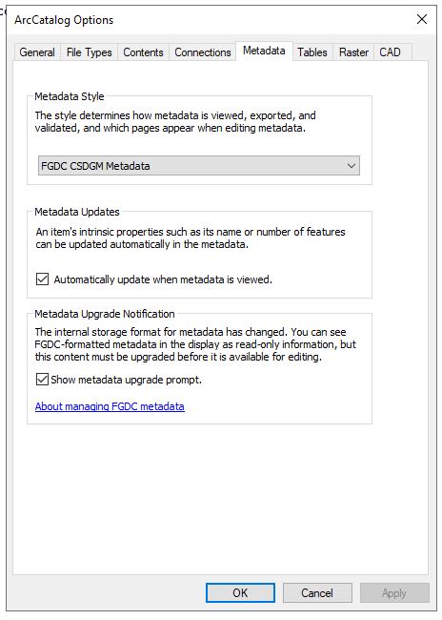
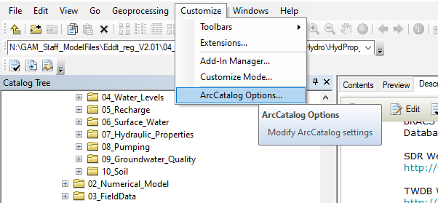
Metadata Style - FGDC
Make sure Federal Geographic Data
Committee (FGDC) style is used to create
Metadata.
Example provided if you are editing metadata
within ArcCatalog.

Slide 3
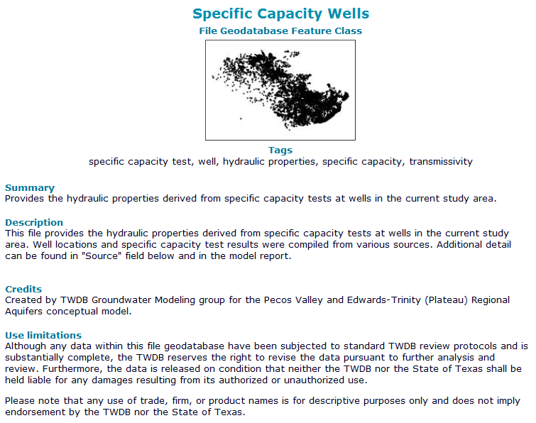
Where to edit Metadata – General Info
1
Use descriptive title. Do not leave file name here.
Upload representative image of dataset.
Add relevant tags.
Provide 1-2 sentence description od dataset.
Provide detailed information, including:
  What is this data?
  Who created the source data?
  Where is this data located?
  When – time period covered by this data?
  (important for data that does not cover
  entire study period)
Provide contact information for this data
(email address)
2
3
4
5
6

Slide 4
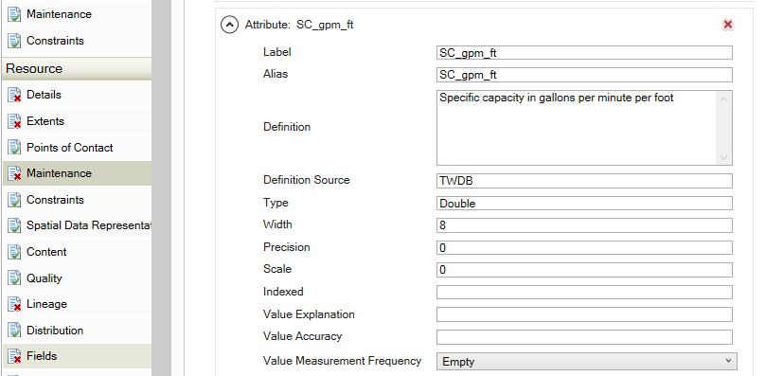
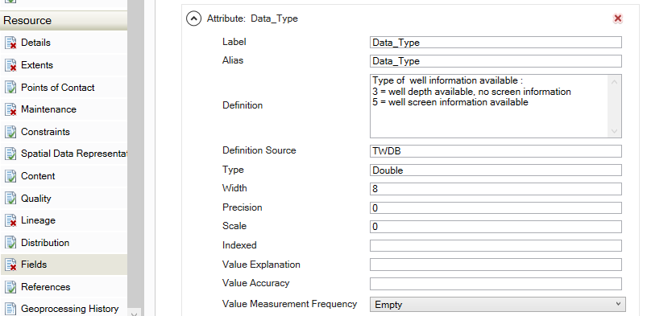
Vector Metadata
Use the Fields Editor. Field Aliases can also be helpful
if field names are not self-explanatory.
Continuous Data
  Definition should include:
    what is the attribute?
    the unit of measurement
Categorical Data
  Definition should include:
    Each category listed
    Definition of each category

Slide 5
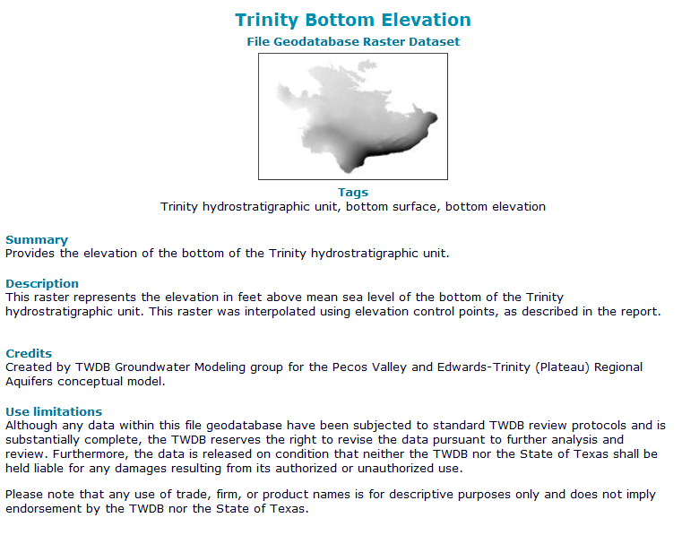
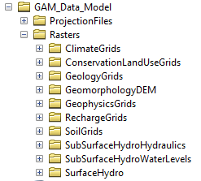
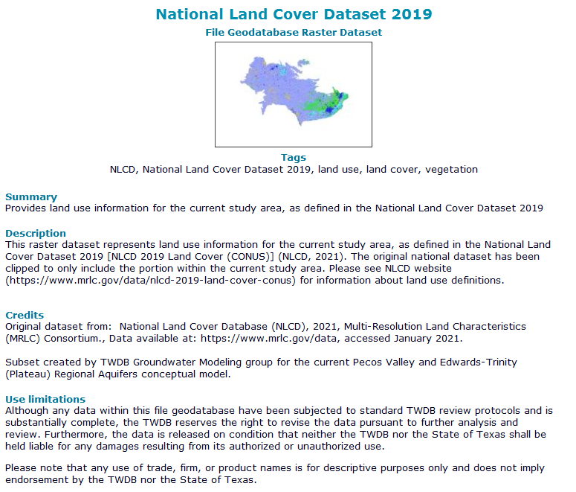
Raster Metadata
Rasters are placed in the Rasters subfolders based on their
category. The contractor is allowed to add subfolders if
the rasters within them are grouped into those folders in a
reasonable way.
Metadata can all be placed in the general “Item Description”
metadata section.
Continuous Data
  Values of raster go in the Description:
    what is the attribute?
    the unit of measurement
Categorical Data
  Values of raster go in the Description:
    Either:
      Each category listed, and definition
      of each category
    Or:
      Weblink to raster metadata is
      acceptable for datasets not created
      by contractor

Slide 6
For Unusual Cases
We understand that not all data will fit into these examples.
Please contact us with any questions about proper metadata before submitting interim/draft/final deliverables
  Send requests to TWDB Contract Manager, or
  Daryn Hardwick, daryn.hardwick@twdb.texas.gov

